Slide 1
Project Management 101
PM for New Product Development (NPI)

Slide 2
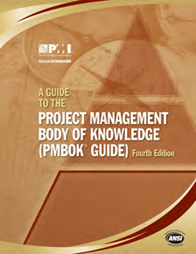

Project Management Professional
PMI is an aggregation of best practices from thousands of professional project managers
Organizations typically use these as a basis for developing custom project management processes
www.pmi.org

Slide 3
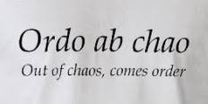

Definition of a Project
A temporary endeavor undertaken to create a unique product, service, or result.
Temporary / Not Ongoing
- Definite beginning and end
- Does not mean a short duration
Unique
- Outcome is a unique deliverable
- Could come in the form of either
products, services or results

Slide 4
Definitions
Matrix Organization - A matrix organization is a company structure where teams report to multiple leaders. The matrix design keeps open communication between teams and can help companies create more innovative products and services. Using this structure prevents teams from needing to realign every time a new project begins.
Project Manager - A project manager is the role a person plays to ensure that a project goes smoothly from beginning to end. A project may have a dedicated project manager, though in some cases the person in the project manager role may have a different title altogether. The project manager is responsible for every step of the project—from ideation to completion—as well as key workflows throughout the entire process.

Slide 5
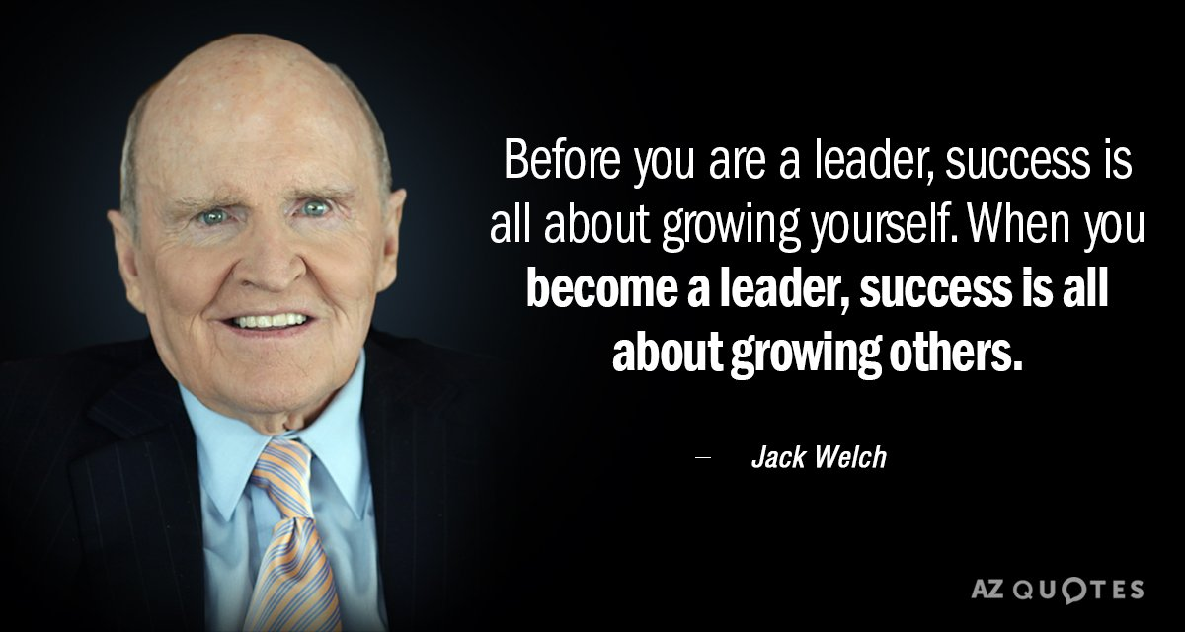
PM Skills
Leadership
Motivation
Verbal Communication
Time Management
Team Management
Organization
Negotiation
Technical Writing
Budget Management
Conflict Management
Risk Management
Problem Solving
Active Listening
Interpersonal Skills
Stress Tolerance
Delegation
Prioritization
Coaching
Critical Thinking
Tenacity
Detail-oriented
Scheduling
Diplomacy
Strategic Planning

Slide 6
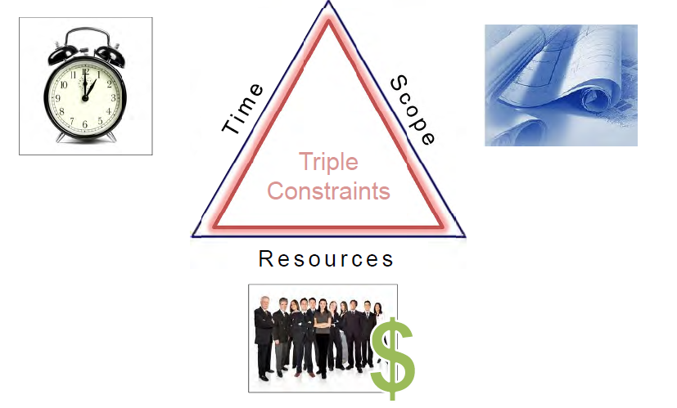
Project Constraints
Managing these are the primary responsibilities of a PM

Slide 7
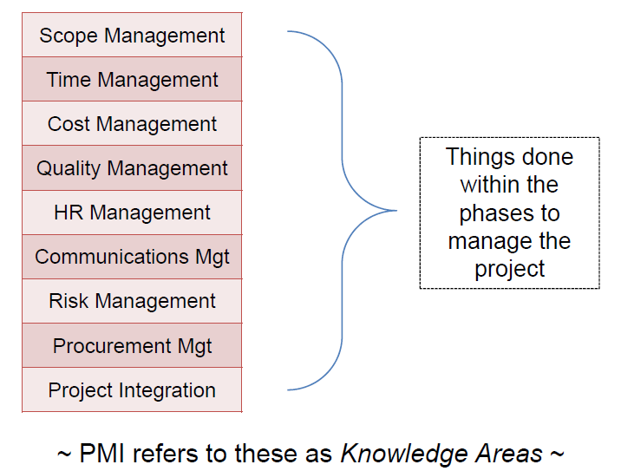
Project Life Cycle
The Five Project Phases
Initiating
Planning
Monitoring
Executing
Closing

Slide 8
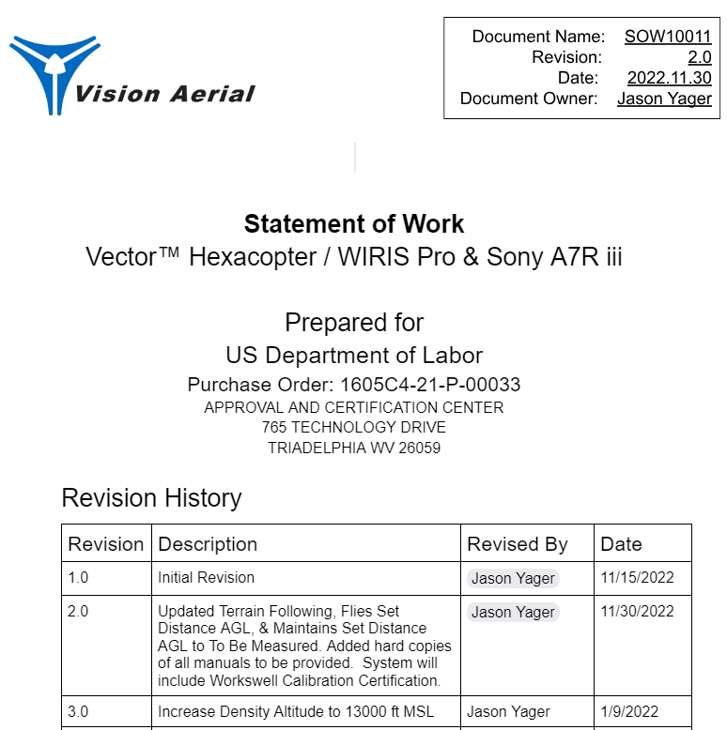
Project Life Cycle: Step 1 - Initiating
Define the request and objectives
Examples
Statement of Work (SOW)
Product Plan
Risks
Scope Creep

Slide 9

Project Life Cycle: Gate 3 - Product Plan
Develop the Product Plan
Costing: Product & R&D
Engineering Specifications
Risk Analysis
  Research & Testing may be required
Product Pricing
Sales Forecast
Return on Investment (ROI)

Slide 10

Gate 4: Development Objectives
One Time
To Specification
To Budget

Slide 11
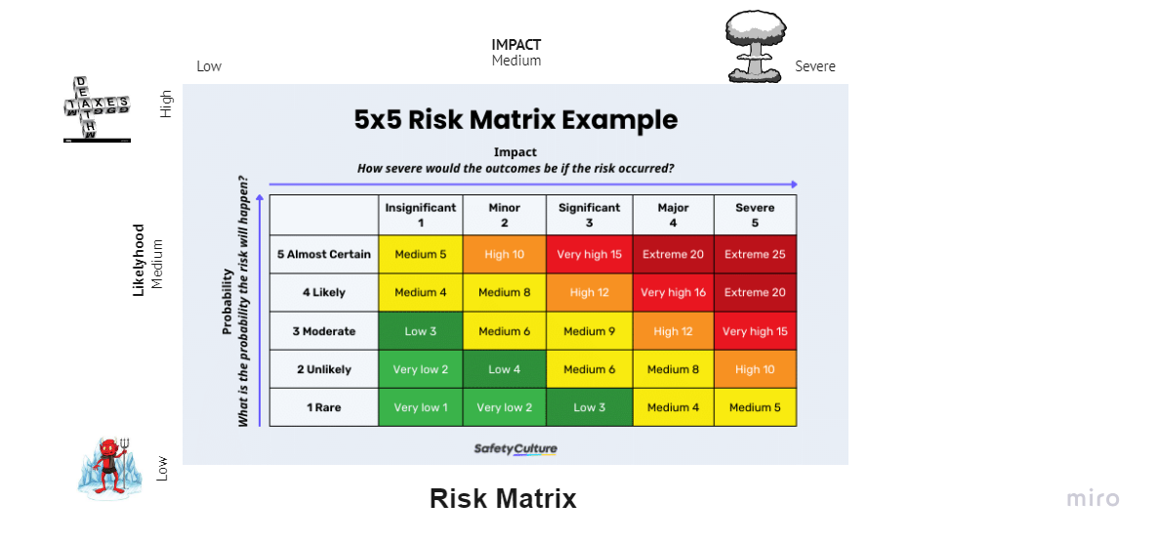
Risk Management

Slide 12
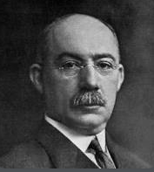
Scheduling - Gantt Charts
Named after Henry L. Gantt (1861–1919), American management consultant.
A Gantt chart is a project management tool assisting in the planning and scheduling of projects of all sizes; they are particularly useful for visualising projects. A Gantt chart is defined as a graphical representation of activity against time; it helps project professionals monitor progress.

Slide 13
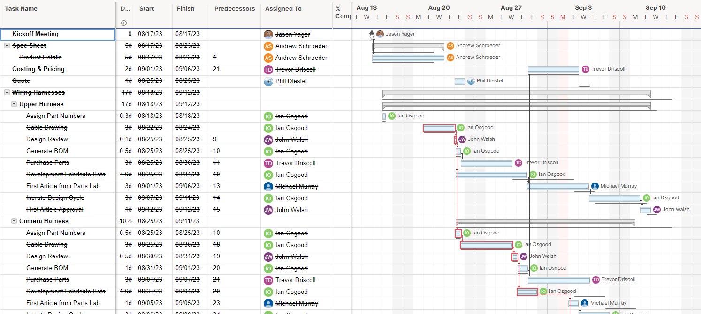
Scheduling - Gantt Charts
Step 1: Set up your project details. ...
Step 2: Add tasks to your project. ...
Step 3: Schedule your tasks. ...
Step 4: Assign Resources
Step 5: Add important project milestones. ...
Step 6: Add dependencies to the tasks that need them.
Step 7: Create a baseline for your project
Step 8: Map critical (Path) dependencies and optimize the dependencies
Step 9: Resource Management
Step 10: Only add margin at the end of the schedule

Slide 14
Agile
Agile approaches to project management aim for early, measurable ROI through defined, iterative delivery of product increments. They feature continuous involvement of the customer throughout the product development cycle. Although agile has its roots in software and IT, agile adoption is growing and expanding in a wide range of industries.

