Slide 1

The Quality Journey
The Path for taking your organization from R&D to high-quality production

Slide 2
Guide: Ben Klein
Quality Manager FLIR Systems, Inc.
B.S. Optical Engineering, University of Rochester
FLIR (Scientific Materials Corp.) employee since January, 2000
FLIR Systems career path
Polishing Technician 2000-2001
QC Technician 2001-2002
QC Supervisor 2002-2007
Quality Manager 2007-present
Training
100 hours of professional development courses
Six Sigma Black Belt
Root Cause
Internal Audits
ISO 9001:2015
Reliability Engineering

Slide 3

Course Agenda
Introduction
Objectives/Goals
Purpose
Problem Statement for the Course
Packing for the Journey
(MPIA Quality team)
Lunch
The System:
Putting it all together

Slide 4
Training Course Objective and Goals
Objective
To provide a practical path forward for small organizations to transition from R&D to high-quality production.
Goals
Through this course you will understand:
The discipline of process as a solution to problems
How a system of processes provides value
Resource strategies for developing and maintaining a system of processes
The processes required to develop and produce quality product
This course will provide a few answers. More importantly, this course will help you formulate the right questions.

Slide 5
Purpose of the Course
To support the MPIA mission.
MPIA Mission
The Montana Photonics Industry Alliance serves as a hub for Montana’s optics and photonics companies, entrepreneurs, laboratories, and universities to commercialize, grow and sustain globally leading organizations that create high quality jobs and economic opportunity in Montana.
MPIA Quality Alliance Mission
We exist to support the growth of the photonics businesses in Montana through the development and implementation of quality processes and superior products and services.
MPIA Quality Alliance Vision
We envision Montana as a recognized world leader in the photonics business.

Slide 6
Common Culture Toward Quality
Differentiate ourselves with the quality of our products
Create a common culture with respect to Quality Product
  Unique perspective towards quality
  Embrace quality as Path
Leverage resources, among the MPIA, related to Quality
  Share implementation strategies
  Share processes, procedures, forms, logs
  Demonstrate examples of systems and processes
Cultivate a shared view toward Quality as a Path.

Slide 7


Problem Statement for the Course
So you have a cool product
You have customers who want it
The customers want you to make a lot of these cool products
Now all of these products have to:
  Look the same
  Behave the same
  Work the same
  Customers receive them when they need them
  Engineers don’t have to build them
  Make your customers happy
Bozeman Lasers, Inc
How hard can it be?
And so the journey begins…

Slide 8

Packing for the Journey

Slide 9


Checklist of Core Supplies for the Journey
Compass
Map
Food
Water and water filter
Cooking gear
Tent
Sleeping bag
Rain Jacket
Clothes
Bear spray
Sleeping Mat

Slide 10
Checklist of Core Supplies for the Journey
Design Process, New Product Introduction process
Manufacturing Flow (Map)
Document Management Process
Engineering Change Control Process
Equipment Management Process
Discrepant Material Process
Service Return Process
Supplier Management Process
Training Process
Problem Solving Process
System Monitoring Process

Slide 11

Questions to Consider
Which processes are most important to you at this time?
Which areas are causing you the most pain?
Which areas are completely new to you?
The answer indicates which ones to focus on first.

Slide 12
Checklist of Core Supplies for the Journey
Design Process, New Product Introduction process
Manufacturing Flow (Map)
Document Management Process
Engineering Change Control Process
Equipment Management Process
Discrepant Material Process
Service Return Process
Supplier Management Process
Training Process
Problem Solving Process
System Monitoring Process

Slide 13
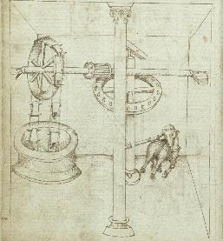
Design and New product Introduction
Steve Birrell
Quantum Composers, CEO
Consultant: Electro-Optical Design,
Producibility, and Production

Slide 14

Design the first step in the quality process.
Quality starts with the design process.
The challenge is how to design and produce a complex product with limited time and resources.
Let’s get started…

Slide 15

Problem Definition
The Challenge:
  Bozeman Laser is designing a new laser using a new, unique and very complex optical configuration.
The Problems:
  How do you insure a robust design that is easy to manufacture and meets all of requirements?
  How can this be done within a reasonable budget and within an acceptable schedule?
  How much modeling, how many prototypes and how much testing should be done?
It is impossible to insure 100% confidence,
the best that you can do is control and manage your risks.
What should we do…

Slide 16

Solution
  Develop a design process, with a disciplined process to transition from each stage to the next.
    Transition using design reviews, check lists, formal sign-off etc.
Research & Development
Develop technical understanding to support a robust design with performance & production margins.
Design for Production
Know your resources (labor, test & measurement, processes)
Transition to Production
Document design, assembly procedures & test procedures. Insure manufacturing is properly trained.
Production
Support
Monitor production for producibility: ease of assembly, test margins, failure analysis. Focus on root causes.
Continue to aggressively support product service,root causes, resolving issues, no bandaids.
Stage/Gate approach to design
There’s a lot to consider…

Slide 17

Research & Development
Develop technical understanding to support a robust design with performance & production margins.
  Identify & Manage the Technical Risks
    80% of the design should be easy, “off the shelf”.
    16% of the design should be moderate, based on previous work.
    4% of the design is the new, hard stuff.
  Focus on the critical “new stuff”.
    More time modeling and analyzing.
    More time testing and qualifying.
    More QC during initial production.
All requirements verified & documented
All material & parts available
Critical design features identified

Slide 18

Design for Production
Know your resources (labor, test & measurement, processes)
Use models, analysis and prototype testing to understand your design, focusing on the 4% new/critical items.
Sensitivity Table – Documents sensitive of components to various errors (size, displacement, tilt, angle, etc.).
Error Budget – Use sensitivity table to develop an error budget, allocating the available tolerances between all of components.
Design to match your internal/external resources.
Prototype meets all requirements, with margin
Drawings & design documentation complete
Analysis/model results documented

Slide 19
Transition to Production
Document design, assembly procedures & test procedures.
Insure manufacturing is properly trained.
Transition starts with a good document control process.
  Simple engineering control process during development.
  Complete document control process when released for production.
Develop tooling, test equipment, assembly & test procedures.
Make sure everyone (technicians, QC, shipping, etc.) is properly trained.
Document everything! Avoid tribal knowledge.
All design & manufacturing documentation released
All training has been completed
All facilities & resources identified & available

Slide 20

Production: New Product Introduction
Monitor production for producibility:
ease of assembly, test margins, failure analysis. Focus on root causes.
Expect problems, statistically this is impossible to avoid.
Engineering should be very active supporting quality and production to identify problems early and review test results for repeatability and margins.
Production yields are consistent & understood
Production processes are efficient and reliable
Areas for design improvement have been identified

Slide 21
Support: New Product Introduction
Continue to aggressively support product service, root cause analysis, resolving issues, no band aids.
Expect problems, statistically this is ‘almost’ impossible to avoid.
Engineering should be very active supporting customers and supporting analysis of defective products.
Any & all issues are valuable data that should be used to improve the design, tooling, procedures, etc.
Minimal product failures
Minimal questions from customers
Happy customers

Slide 22
Questions to Ask Yourself
?
Have you found yourself late in the design wishing you had addressed something earlier in the process?
Have you discovered a serious flaw in the design late in the design or during production?
Did you discover that the design was too hard for a technician to build?
Are you still debating performance specs while in production?
Are you having trouble finding vendors for production during the transition to production?
When entering production are you missing prints, work instructions, fixtures, etc.?
Quality starts with the design!

Slide 23
Checklist of Core Supplies for the Journey
Design Process, New Product Introduction process
Manufacturing Flow (Map)
Document Management Process
Engineering Change Control Process
Equipment Management Process
Discrepant Material Process
Service Return Process
Supplier Management Process
Training Process
Problem Solving Process
System Monitoring Process

Slide 24



Manufacturing Flow
John Malachowski
Manufacturing Manager
14 years
15 years

Slide 25

Challenge: Manufacturing Flow
Problem: There is an abundance of work-in-process, but an absence of finished-goods inventory
Customers calling about late shipments and the ones that do arrive do not meet all specs
Customers are beginning to lose trust in our ability to meet their expectations
Manufacturing team unable to repeatably produce high-quality lasers on time
Qty Work in Process = 5
Qty Ready to Ship = 0

Slide 26
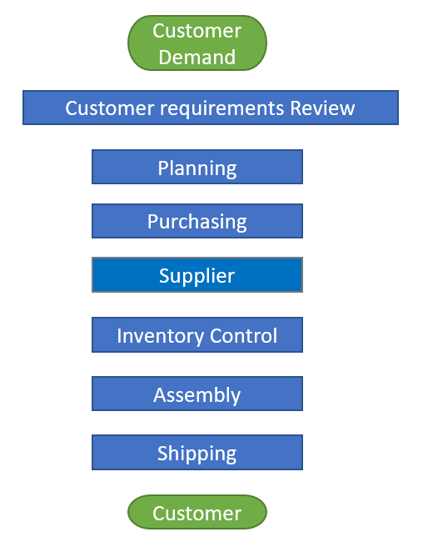
Establish Manufacturing Process to Create Flow
Solution: Design a process that produces lasers that meet the customer’s expectations of quality and delivery
Confidence is high that we can meet the customers’ expectations when they engage our company
All production demands are assessed and produced utilizing a disciplined manufacturing process
All customer expectations are met resulting in increased customer confidence and increased sales
Make good decisions weighing both customer expectations and organizational capabilities
Accurately allocate manufacturing resources to meet customer expectations
Manage materials acquisition to meet production demands
Establish partnership relationship with suppliers based on quality, cost and on-time delivery
Repeatable methods of controlling materials throughout entire manufacturing process
Establish standard work instructions/flow that recognize the value of design, fixtures, and trainable techniques and procedures.
Ensure that all customer expectations are met prior to any product leaving the facility.

Slide 27
Manufacturing Concepts
WORKPLACE CULTURE
CUSTOMER SERVICE
PROCESS TIME
TOYOTA PRODUCTION SYSTEM
WORLD-CLASS MANUFACTURING PROCESS
STANDARD WORK
THEORY OF CONSTRAINTS
LEARNING ORGANIZATION
DESIGN FOR MANUFACTURABILITY
LEAN
LABOR CAPACITY
VISUAL MANAGEMENT
LEAD TIME
RESOURCE MANAGEMENT
MATERIAL CONTROL
PROCESS DISCIPLINE
OPERATIONAL EXCELLENCE
Pursue manufacturing concepts to create excellence!

Slide 28
Questions to Ask Yourself
?
Are you Over Producing?
Do you have the right inventory?
Do your operators/techs find themselves waiting?
Does your material flow in the shortest path?
Do your take unnecessary steps or movements?
Are you doing more than necessary to meet customer expectations?
Are you struggling with quality / defects?
Are you fully utilizing your talent?
Understanding these questions is your first step on the path to Lean Manufacturing

Slide 29
Checklist of Core Supplies for the Journey
Design Process, New Product Introduction process
Manufacturing Flow (Map)
Document Management Process
Engineering Change Control Process
Equipment Management Process
Discrepant Material Process
Service Return Process
Supplier Management Process
Training Process
Problem Solving Process
System Monitoring Process

Slide 30


Document Management Process
Kim Rollefson & Conlin Ritter

Slide 31
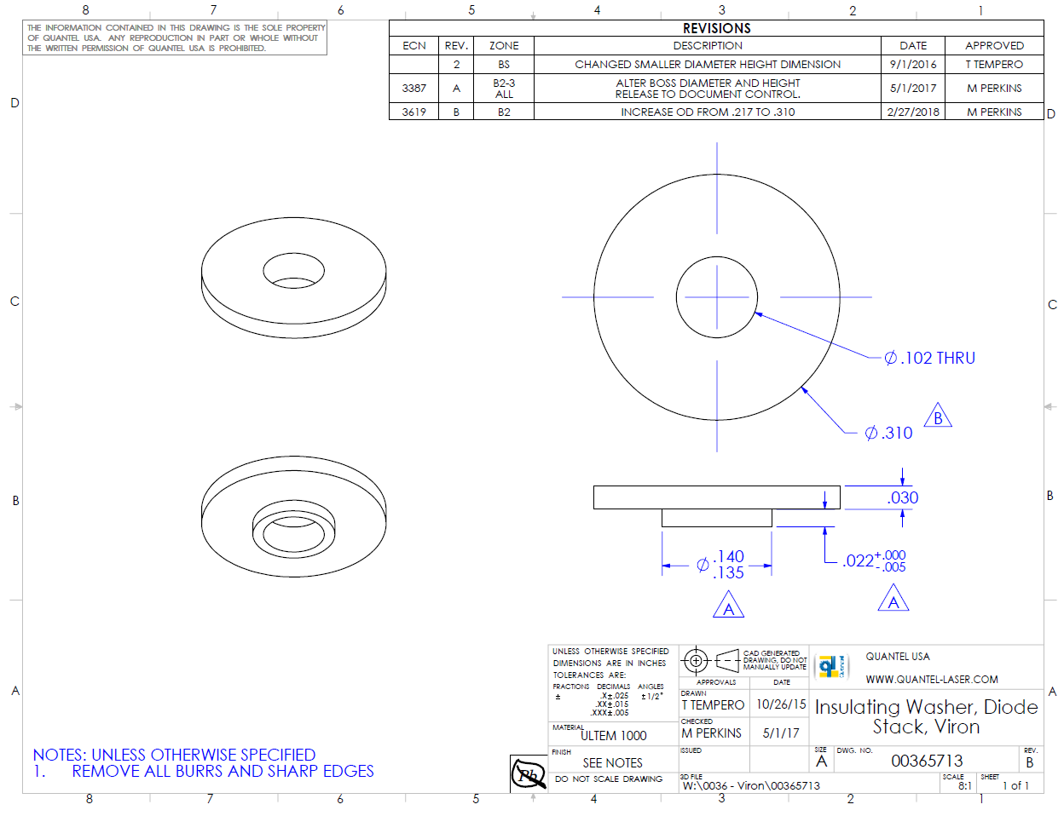
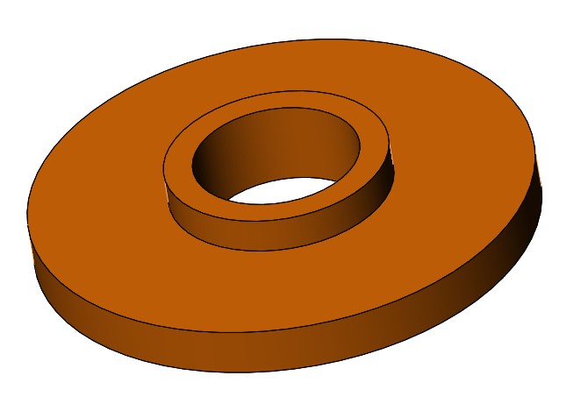
Background Information (Context)
A simple insulating washer used inside a solid state laser system.
This washer provides electrical insulation between mating components, as well as preventing other nearby metal parts from touching electrical contacts.
If the metal parts touch the electrical contacts, a short can occur and the system will stop working.
Notes:
Simple, but important part!

Slide 32
Document Management: Problem
Problem: The washers are ordered, received, pass incoming QC, are cleaned, and put in to production, however electrical parts start shorting and damaging during assembly.
Investigation determined the washers were made to an old revision and the O.D. is too small. The parts will need to be scrapped and replaced.
Two week lead time to get replacement parts. Production schedule is interrupted. Delivery schedules to customers are at risk. Damaged parts need to be replaced. Resources investigating the cause. $$$$$$$$$$$$$$
A design change was made but not formally communicated to the supplier or the incoming inspector.
Simple Part, Minor Change, Significant Impact
Notes:
Simple part, minor change, Large impact to quality of product (potential for products failing in the field)!

Slide 33
Document Management Process
Solution: Design a process to create, store, and make changes to information needed to build your product (Change/Engineering Control Process).
Documents are stored in a central location and changes are managed by a Document Control person. Everyone has access to the most current version of the documents they need and changes are validated, approved and distributed accordingly.
Return, rework and scrap rates have declined.
Do it right the first time!

Slide 34
Engineering Change Control Steps
Authorization
Should the change even be made?
Will the change appropriately resolve the issue? Are there other related controlled items that will need revision (Work Instructions, Quality Control forms, etc.)
Validation
Make Change!
Create new/updated document.
Approval
Submit change to review from representatives of all impacted parties (Customer Service, Production, Purchasing, etc.)
Store new revision in central storage area. Archive old revision (for Customer Service & Engineering reference). Update Stock, Open Work Orders, purchasing info, inspection plans, work instructions, etc.
Implementation
Distribution
Document Manager notifies all relevant employees of change. Purchasing notifies Suppliers.
Notes:
Some companies will change PN for any change to form, fit, or function; others will only change the Rev. Do at least one of these things!

Slide 35
Document Control System
Characteristics of Controlled Documents
Should It Be Controlled?
Document Title
Document Number
Revision Level
Process for making changes
Common Format
Revision History Table
Proprietary Statement
Stored in Document Library
  Central Location all can access
  Current Revisions
  Limited Edit Access
Do you want it safe?
Do you want a record of changes?
Do you want everyone working to the same version?
Do you want to find it fast?
Examples of Controlled Documents:
Work Instructions
Specifications
Drawings
Procedures
Forms
Regulatory Requirements and Standards

Slide 36
Common Characteristics of Controlled Document
Revision History
Title
Revision
Doc number

Slide 37
Questions to Ask Yourself
?
Have you ever ordered the wrong revision part?
Have you built an assembly using the wrong type of materials?
Do you have failures in the field because a change designed to prevent an intermittent failure had not been implemented?
Are you struggling to figure out what the latest drawing/procedure is and where to get it?
A minor change to a simple part can have a significant impact on the quality of your product. Having a Document Control Process can provide you with the consistency you need to build quality into your products, train new employees, reduce rework and scrap and thereby increase profitability.

Slide 38
Checklist of Core Supplies for the Journey
Design Process, New Product Introduction process
Manufacturing Flow (Map)
Document Management Process
Engineering Change Control Process
Equipment Management Process
Discrepant Material Process
Service Return Process
Supplier Management Process
Training Process
Problem Solving Process
System Monitoring Process

Slide 39
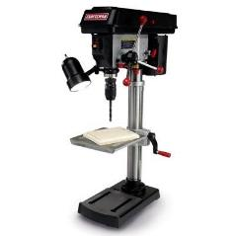

Equipment management
Process
Mary Johnson
CEO
Wavelength Electronics
Robert Martin
Quality Manager
Autopilot

Slide 40


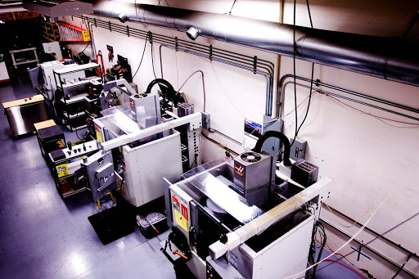

High Performance Electronics:
Laser Diode and QCL Drivers &
Temperature Controllers
Two SMT lines – Stencil printer, Pick-and-Place robots, reflow ovens
Selective Solder machine
Electronic meters
Hand tools
World Class Design and
Manufacturing
Contract design and manufacturing services
CNC milling, turning, anodizing, laser etching, assembly, packaging, etc.
ISO 9001/AS9100 Compliant Quality Management System
Required to meet customer spec’s, costs, and timelines
Notes:
Who is Wavelength
Wavelength Electronics Inc. was founded in 1992 by husband and wife Chuck & Mary Knighton. Chuck is now Chief Technical Officer and Mary is CEO. Both have degrees in Electrical Engineering.
Wavelength is a privately held corporation.
Early on, only instrumentation was available for operating laser diodes and thermoelectrics. We saw an opportunity to offer the technology packaged as components and modules. We have successfully tapped several markets averaging 26% growth annually.
In short, Wavelength simplifies advanced control technology so innovative tool developers with limited electronic design resources can achieve cutting edge performance.
Our technology platform currently consists of high performance temperature controllers and laser diode drivers.
Temperature Control == best commercially available temperature stability 0.001°C
Laser Diode Drivers == lowest noise, most stable current source ???
The high performance platform is accompanied by innovative packaging that makes the technology easy to use
R&D works with various universities on core control technology research. We will be introducing a new control technology this summer.
Thorough, Reliable, Responsive Technical Support is key to establishing the position of authority & knowledge with customers.
We have developed sophisticated web based tools to enhance technical support. These include searchable FAQs, design calculators, and technical and application notes.
We have a facility in Bozeman, Montana, USA. Services includes sales and technical support, engineering, and low volume / high mix manufacturing. High volume manufacturing is sub-contracted.
Our primary success has been with these markets: electro-optics, semiconductor manufacturing, bio-medical, military, research and university. We have had some success with the fiber optic and telecom markets and want to team with Richardson to more thoroughly serve these customers.

Slide 41
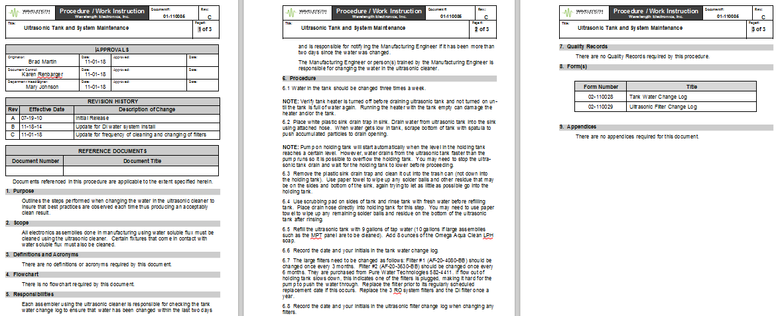
Preventive Maintenance
Preventative Maintenance
Problem: If the Ultrasonic Cleaner doesn’t clean flux off the printed circuit boards, production stops OR products fail in the field
Solution: Daily, Weekly, Annual maintenance protocols
  Established based on testing and our experience
  Documented with logs to make sure it’s done & if something goes wrong we have a dated history (traceability) to research root cause

Slide 42
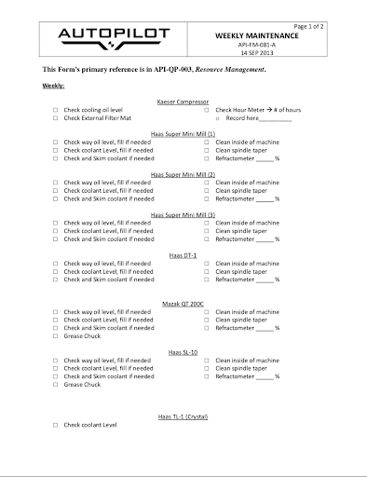
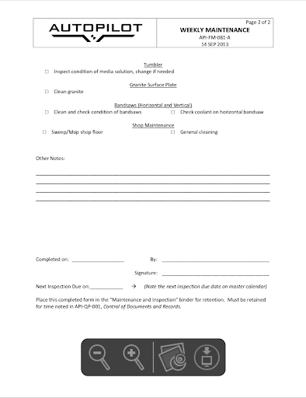
Preventive Maintenance
Problem: A project specific tool change guideline was not followed leading to a machine crash
Solution: Daily, Weekly, Monthly, Quarterly, Annual maintenance protocols
Machine maintenance recommendations pulled from manuals, then transcribed onto maintenance records to streamline process
Documented with records to make sure it’s done & if something goes wrong we have a history to research root cause

Slide 43
Calibration
Calibration
Calibration
Problem: If units pass test when meters are out of calibration, we are not measuring what we think we are measuring. RMAs increase and customers are not pleased.
  Applies to meters, oscilloscopes, power supplies, spectrum analyzers...
Solution: Electronic test results must be NIST traceable.
  Bring in third party to calibrate on-site every 51 weeks. Record Before & After data.
  Share travel cost with another local company

Slide 44
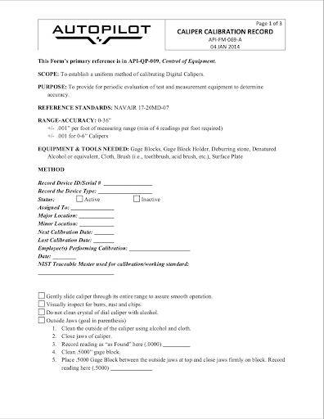


Calibration
Problem: If our measuring tools are not accurate and precise, we are not measuring what we think we are measuring, and customers send back more parts.
Applies to calipers, depth gauges, etc.
Solution: Create detailed process and form for calibration
Created from industry best practices
Detailed enough that anyone given proper materials could calibrate
Doubles as a record for tracking frequency of testing and life of precision tools

Slide 45
?
Questions To Ask Yourself
What Questions to Ask?
What questions to ask...
Preventative Maintenance
  Do you have equipment that can wear out, but is critical to throughput & efficiency or product performance?
  Do you know it’s been maintained adequately?
  Will you know when something is going out before you have a pile of scrap?
  Do you know the maintenance needs
  and costs of new machines you’re
  adding to your process?
Calibration
  Do you have measurement equipment
  you depend on to ensure product
  meets specification?
Maintaining key infrastructure prevents line down in production!
Calibrating your measuring equipment gives you confidence in your products

Slide 46
Checklist of Core Supplies for the Journey
Design Process, New Product Introduction process
Manufacturing Flow (Map)
Document Management Process
Engineering Change Control Process
Equipment Management Process
Discrepant Material Process
Service Return Process
Supplier Management Process
Training Process
Problem Solving Process
System Monitoring Process

Slide 47
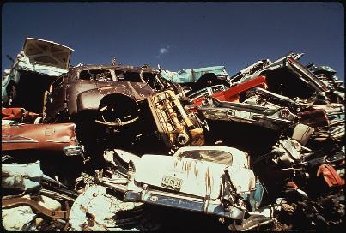
Managing Discrepant Material
Ben Klein
Quality Manager
FLIR Systems, Inc.

Slide 48
Discrepant: Definition
Definition: differing, disagreeing, inconsistent (dictionary.com)
Discrepant may be nonconforming (does not meet specification per drawing)
Discrepant may not be nonconforming
  Doesn’t fit due to tolerance stack-up, strange color, finish isn’t quite right
Sources of discrepancy
Incoming inspection – generally supplier caused)
During manufacturing – either supplier or process caused)
Returns from customer - Service Returns

Slide 49

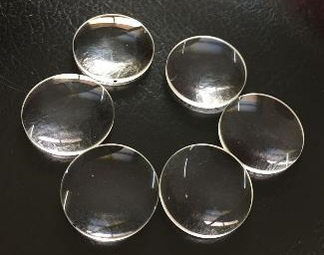
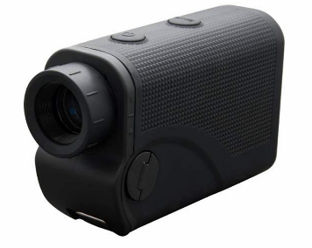
Discrepant Material: Problem
Problem: Discrepant lenses are starting to pile up next to the final assembly station
A laser was accidentally built and shipped with one of the discrepant lenses
Two months later, the Customer returned the Laser because it “stopped working”
The laser fried a bunch of parts because of discrepant lens. Cost thousands of dollars to repair! $$$$$
Bozeman Lasers

Slide 50
Discrepant Material: Solution
Solution: Design a process initiated any time Discrepant Material is encountered
Label Discrepant Material and Segregate
Record information in Discrepant Material Log
Evaluate Discrepant Material
Update Discrepant Material Log
Scrap
Rework/Repair
Return to suppler
Use as is
Determine Disposition
Disposition Material

Slide 51
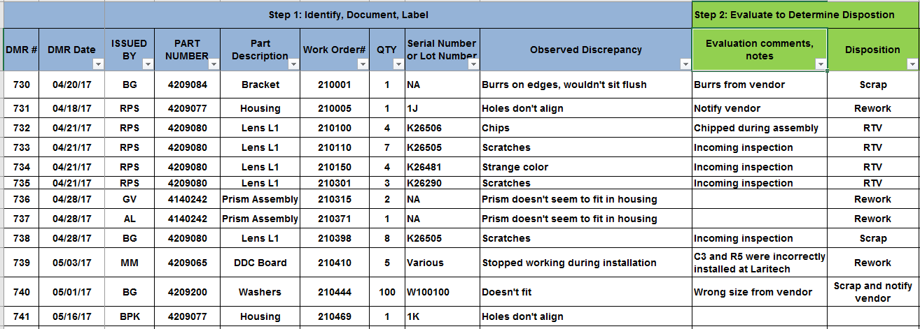
Discrepant Material Process
Discrepant Material is never accidentally incorporated into final product.
A record of Discrepant Material is generated. Trends lead to improvements.
Returned material has declined. Manufacturing costs decreased. Improved yield.
Discrepant material gives insight regarding the design, the performance of your suppliers, performance of your processes.

Slide 52

Service Returns: Problem Statement
Problem: Lasers returns are increasing in qty
Returned lasers are misplaced; long time before returning to the customer
Customers are not happy and considering another source for lasers
We have no idea how many are returning and no idea of the product reliability

Slide 53
Service Return Process: Solution
Solution: Design a process initiated any time Lasers are returned by a customer
Label the Returned Material
Record in Log
Evaluate Returned Material
Updates Log
Warranty
Determine Warranty Status
Non Warranty
Determine Disposition
Replace
Rework/Repair
Return to Customer
Disposition
Return to Customer

Slide 54
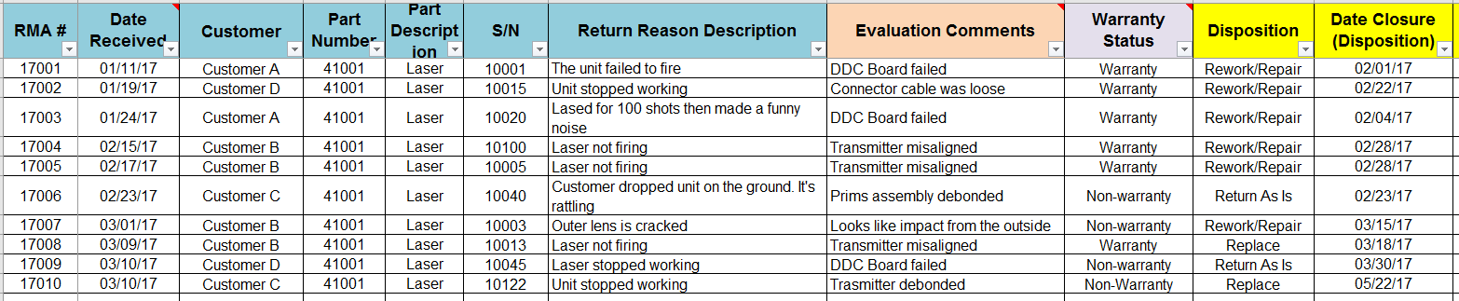
Service Return Process
A record of Returned Material is generated and tracked in a log
Returned Material isn’t lost or forgotten, trends identified lead to improved design/process
Log can be used to generate graphs (see next slide)
Each return event is an opportunity to improve relationships with your customers and build greater trust
How you respond to a return event is a moment of truth!

Slide 55
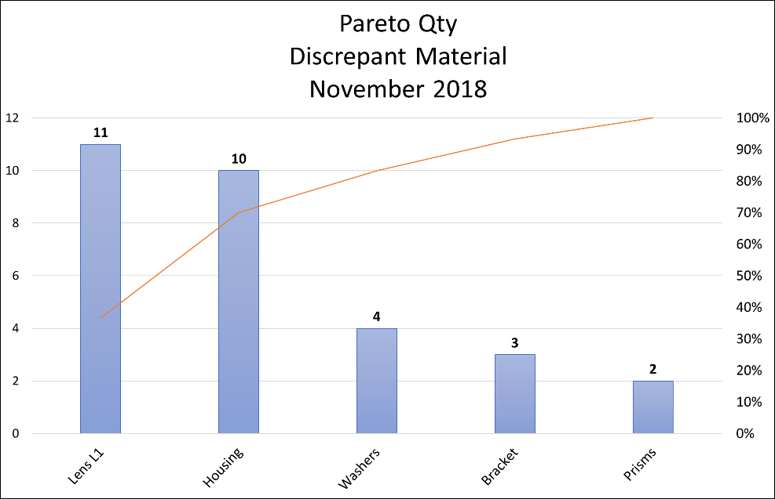
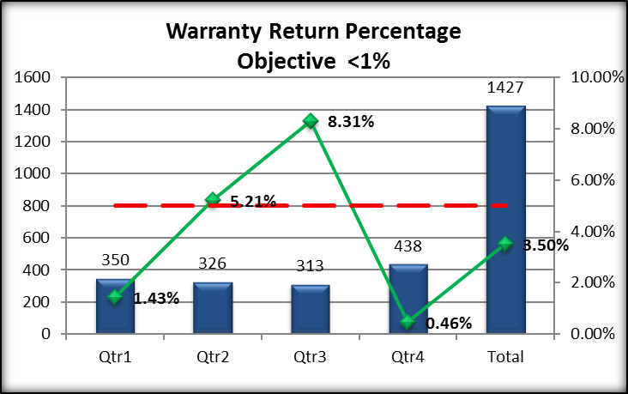
Discrepant Material Reports
Warranty Returns
Logs Provide Data
Design Change
Process Change
Supplier Change
Improvement

Slide 56
Questions to Ask Yourself
?
Do you know how many materials are being rejected from your suppliers?
Do you know how many materials are being damaged during production?
Do you know how many of your products are being returned from your customers?
Do you know what kinds of trends you are seeing in the returned products?
Understanding what doesn’t work leads to understanding what does work!

Slide 57
Checklist of Core Supplies for the Journey
Design Process, New Product Introduction process
Manufacturing Flow (Map)
Document Management Process
Engineering Change Control Process
Equipment Management Process
Discrepant Material Process
Service Return Process
Supplier Management Process
Training Process
Problem Solving Process
System Monitoring Process

Slide 58

SUPPLIER
MANAGEMENT Process
Kurt Borge
Quality Consultant
Quality Time Montana, LLC
One of the most common problems
companies have is poor supplier quality

Slide 59
Example problem: Custom coated optics being rejected by Bozeman Laser
Delivery 1 year behind schedule
Order bid at $1 million, cost $2+ million for supplier to manufacture
Company morale going down

Slide 60
Cause: Bozeman Laser quality specifications were too tight
Bozeman Laser specification had tolerances too tight, which is creating high reject rate
Bozeman Laser Quality Department and supplier did not review specifications to detect the unrealistic tolerances

Slide 61

Solution: new purchasing procedure
However, Bozeman Laser recognized the problem as a lack of controls for their purchasing process
Bozeman Laser developed purchasing procedure for:
Creating realistic quality specifications and communicating to suppliers
Selecting good suppliers and making agreements with them
Notes:
Agreements: Inspection plans, AQLs, NCM disposition

Slide 62
Bozeman Laser Purchasing Procedure
SPECIFICATIONS CREATED
SPECIFICATIONS REVIEWED
SUPPLIER(S) SELECTED and QUALITY AGREEMENTS MADE
PURCHASE ORDER WITH SPECIFICATIONS SENT TO SUPPLIER
PARTS RECEIVED AND INSPECTED BY BOZEMAN LASER
REJECTED PARTS RETURNED TO SUPPLIER
OK?
GOOD PARTS GO TO MANUFACTURING
DATA
DATA
Notes:
Purchasing, Engineering, Manufacturing, Quality.
Rejected parts and supplier performance data used to monitor supplier quality.
Cause of problem could be with the specifications or communication issures.

Slide 63
Conclusions
The Bozeman Laser Purchasing Procedure:
Reduces the risk of getting bad parts
Provides data for Supplier Monitoring and Improvement

Slide 64
Questions to ask yourself
?
Are you having problems getting parts delivered on time?
Are you sole sourcing your parts?
Are your lead times accurate?
Without backup suppliers, your production is captive to one supplier. Risk missing production schedules.

Slide 65
Checklist of Core Supplies for the Journey
Design Process, New Product Introduction process
Manufacturing Flow (Map)
Document Management Process
Engineering Change Control Process
Equipment Management Process
Discrepant Material Process
Service Return Process
Supplier Management Process
Training Process
Problem Solving Process
System Monitoring Process

Slide 66

Training Process
Mary Johnson
CEO
Wavelength Electronics

Slide 67
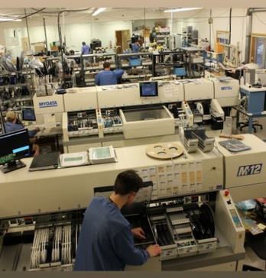

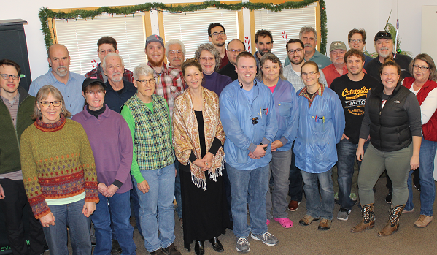
WEI Electronic Assembly Staff
Electronic Assembly Staff
What questions to ask...
Buyers
Receiving
Schedulers
Manufacturing Engineers
SMT operators
Selective solder operators
Hand assemblers
Testers
Technicians to rework & troubleshoot
Final packagers
Shipping clerks
Notes:
Who is Wavelength
Wavelength Electronics Inc. was founded in 1992 by husband and wife Chuck & Mary Knighton. Chuck is now Chief Technical Officer and Mary is CEO. Both have degrees in Electrical Engineering.
Wavelength is a privately held corporation.
Early on, only instrumentation was available for operating laser diodes and thermoelectrics. We saw an opportunity to offer the technology packaged as components and modules. We have successfully tapped several markets averaging 26% growth annually.
In short, Wavelength simplifies advanced control technology so innovative tool developers with limited electronic design resources can achieve cutting edge performance.
Our technology platform currently consists of high performance temperature controllers and laser diode drivers.
Temperature Control == best commercially available temperature stability 0.001°C
Laser Diode Drivers == lowest noise, most stable current source ???
The high performance platform is accompanied by innovative packaging that makes the technology easy to use
R&D works with various universities on core control technology research. We will be introducing a new control technology this summer.
Thorough, Reliable, Responsive Technical Support is key to establishing the position of authority & knowledge with customers.
We have developed sophisticated web based tools to enhance technical support. These include searchable FAQs, design calculators, and technical and application notes.
We have a facility in Bozeman, Montana, USA. Services includes sales and technical support, engineering, and low volume / high mix manufacturing. High volume manufacturing is sub-contracted.
Our primary success has been with these markets: electro-optics, semiconductor manufacturing, bio-medical, military, research and university. We have had some success with the fiber optic and telecom markets and want to team with Richardson to more thoroughly serve these customers.

Slide 68

Training Process Evolution
What questions to ask...
Problem: Sales have increased! I can’t do it alone...
Solution: Hire employee #2, train them
Training looks like building together, one-on-one
Gather the right tools to make the work more efficient
Break down the assembly steps so each person can do a piece & it gets faster & more consistent (specializing)

Slide 69
Training Process Evolution
What questions to ask...
Problem: Company is growing! I don’t have time to train!
Solution: Employee #2 trains employees # 3, 4, 5
To make sure the right stuff is communicated, write up a training document – For WEI, that’s an Assembly Ticket
Train Employee #2 to train correctly
Establish time standards & workmanship standards & measure

Slide 70
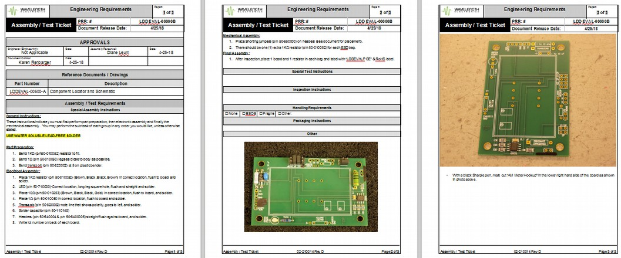
Example Assembly Ticket
a.k.a. Work Instruction
What questions to ask...
Example Assembly Ticket

Slide 71
Training Process Evolves
Problem: Sales have increased! RMAs, too...
One widget takes 0.5 hours to build & 3 hours per RMA—so RMA’s are very expensive to deal with
Solution: Root cause analysis & retraining
Edit Assembly Ticket to avoid failures
Develop training content plan so Trainer knows what to cover
Develop training record forms to know who is trained to do what
Look for industry standard training – IPC for electronics

Slide 72
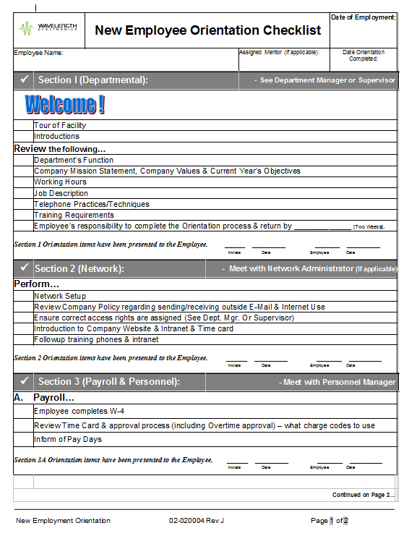
Training Record Example
Training Record – Example
Training Records - Examples
Training Requirements on New Employee Orientation form
IT
HR forms
Safety

Slide 73
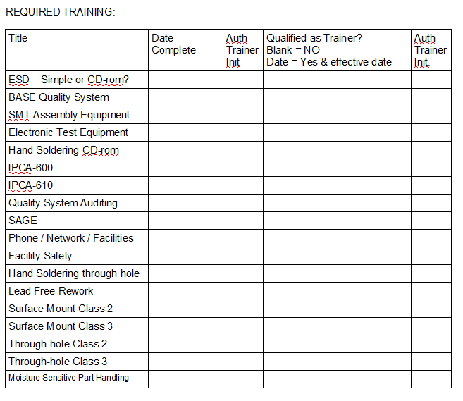
Training Record Example
Training Record Example
Training Records - Examples
Training Requirements Matrix on Job Description
IPC training – ESD prevention, soldering, inspection, component ID
BASE Quality System
Equipment knowledge relevant to the job
Training done & Trainer status recorded on Job Description

Slide 74
Training Process Evolves
Training Process Evolves
Problem: Key employees leave: lose 25 years experience
How much knowledge is written down?
Solution: Hire right, train thoroughly, measure basics
Edit Assembly Tickets to document everything possible before key employees leave
Hire conscientious people, train, measure First Pass Yield, do root cause analysis on failures, let them learn & improve
Cross train

Slide 75
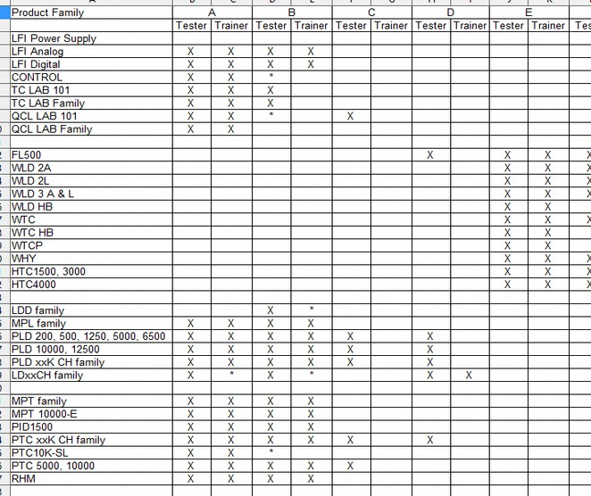
Training Record – Cross Training
Training Record – Cross Training
Cross Training Log

Slide 76
?
What Questions to Ask?
Questions to Ask Yourself
Cross Training Log
What questions to ask...
Do you know how to build your widget?
Do you know how to teach someone else to build it?
Do you know how to teach someone to train someone else to build it?
Do you know if the person building it has been trained?
Do you know if their training was adequate & recent?
Is the team able to handle absences?
If someone leaves, can someone else do their job?
Have you ever had a problem because of lack of training?
Create a Learning Organization

Slide 77
Checklist of Core Supplies for the Journey
Design Process, New Product Introduction process
Manufacturing Flow (Map)
Document Management Process
Engineering Change Control Process
Equipment Management Process
Discrepant Material Process
Service Return Process
Supplier Management Process
Training Process
RCCA Problem Solving Process
System Monitoring Process

Slide 78

Root Cause and Corrective Action (RCCA)
Daniel Juliano, Ph.D.
Director of the MSU Technology Transfer Office
MSU TechLink

Slide 79
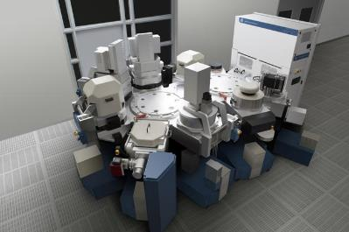
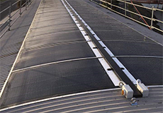
My Background
16 years in Silicon Valley as engineer and manager of
  Technology development
  Product engineering
  Pilot manufacturing
Semiconductor Capital Equipment
Lightweight Flexible Solar Panels
Notes:
Spent my career developing technology, processes, and hardware in some very high tech industries with all sorts of engineering problems to solve. The tool in the left photo would go in a semiconductor fab cleanroom, and costs $5M to $7M. For scale reference, floor tiles are 2’ x 2’.
The last company I worked for was a solar startup, where we developed thin film solar panels (i.e. not containing silicon), including designing and building our own custom equipment for the manufacturing line. For reference, these panels are 1m wide, and around 1.5m long.
So, again, we had lots of engineering problems to address. It was essential to take an efficient and structured approach to these problems. We had a few tools that we frequently used, because they were so useful. One of the most important and most useful was the RCCA process.

Slide 80
Example
Background:
  Bozeman Laser Company has developed some unique technology, and their first product has been a hit.
Problem:
  Initial success has resulted in a growing burden on engineering, production, and customer service in dealing with unexpected problems.
Impact:
  Everyone is so busy “fighting fires” that it has become a serious resource drain and threatens the sustainability of the business.
How to dig out from under this crushing burden and avoid it in the future?
Notes:
Let’s start with a motivational example problem.
To some extent, the way to fix or avoid this problem is to do all the things we are talking about today.
But one big thing you must do is to only solve problems once, and to do so in a way that keeps your products and processes as simple as possible. That can be done with a structured problem solving technique that is relatively easy to understand and use but very powerful.

Slide 81
RCCA elements
Title & RCCA #
Executive Summary
Containment
Root Cause
Corrective Action
Action List
Signoff
7 elements to this RCCA template—
all critical to the effectiveness of the process
Notes:
The process we used we called RCCA – Root Cause and Corrective Action. I want to be clear that it is not specific to engineering or technical problems. It can be applied to just about anything, including issues you might encounter at home! We didn’t invent RCCA but did simplify and customize it in order to make it as efficient as possible for technical problem solvers, with minimum jargon and maximum impact. The 7 slides I am about to show you can act as a template you can use to implement this process yourself.

Slide 82
RCCA #
Title:
Date:
Owner:
Notes:
RCCA # because all RCCA’s tracked somewhere—spreadsheet, database, Sharepoint, etc. to ensure they are driven to closure and for future reference. This is a form of traceability.
Owner is key for accountability.

Slide 83
Executive Summary
Problem Statement
What was the impact and why do we care about it?
Current Status
Notes:
Problem Statement is key. Easy to go wrong here. Don’t express problem in terms of the solution. Problem is NOT “we need to….”
The question makes the problem easier for people to relate to, and keeps them focused and motivated.
With Current Status, this slide serves as a 1 page summary of the issue; evolves with time. An executive, or a new team member, should be able to look at this slide and get oriented to the project in <10 seconds.

Slide 84
Containment
What was the Containment?
What are the risks associated with the Containment?
How do we monitor the situation before implementation of the Corrective Action?
Notes:
Containment is a Band-Aid, put in place to manage the problem in the short term. Organizations tend to put in place a containment and then forget about the problem, which doesn’t really SOLVE anything. There are also big risks of causing new issues with the containment, and/or having the containment eventually fail.
Questions on this slide help mitigate risk, while emphasizing the temporary nature of the Containment.
Narrative format of the questions helps step the team through the process, together.

Slide 85
Root Cause
What was the Root Cause?
Why should we believe it was the Root Cause?
Notes:
This is the core of the process, and where most of the work will be done. Can and should use tools such as Pareto Charts, Fishbone Diagram, 5 Why’s, etc. to find root cause. Need to address the root cause in order to systematically fix the problem and prevent recurrence. (Hint: root cause is almost never “operator error” or similar blame that can be placed on a person. Instead look at procedures, policies, practices, equipment, training, and the like which can be changed to SYSTEMATICALLY address the problem.)
Cannot overstate the importance of looking for SYSTEM causes rather than people to blame—without this forward looking approach, you will breed a dysfunctional CYA culture, and will never have an honest and objective RCCA investigation. Everyone will be too busy trying to avoid blame.
This step is the easiest to mess up—people are in a rush, the root cause may seem obvious…but if you get it wrong, you will pay for it later. So the second question is a pre-emptive challenge, reminds the team that there will be a critical public review of their work. They need to be data-driven, and truly demonstrate that they’ve found the root cause.

Slide 86
Corrective Action
What was the Corrective Action?
Why should we believe the same problem will not occur again?
Notes:
Corrective action methodically and systematically addressed the root cause. R C C A
Second question → gets to what is sometimes called the Preventative Action. What can we do proactively to avoid a repeat? Net result is that every RCCA completed makes the organization stronger, more capable, more robust. It’s a mechanism of continuous improvement for the organization.

Slide 87
Action List
Owner | Description | Due Date | Status
Notes:
This action list is likely to be a subset of a larger list kept in Excel format.
If you have a way to reliably track and close action items, you can close the RCCA as soon as you have identified all necessary actions. If not, leave the RCCA open until all related actions are closed.

Slide 88
RCCA Signoff
Name | Position | Approval Signature | Date
 | Technology Manager
 | Engineering Manager
 | Production Manager
 | Quality Manager
 | Etc.
Notes:
Each company will want to customize the signoff list, which should be as short as is prudent—recommend 3 to 5 key people. After completion, the RCCA PPT should be archived, along with the associated data and other project files, for future reference.

Slide 89
RCCA Process Steps
Executive Summary – Define the problem
  Problem Statement
  What was the impact and why do we care about it?
  Current Status
Containment – Immediate action to manage the problem
  What was the Containment
  What are the risks associated with the Containment?
  How do we monitor the situation before implementation of the Corrective Action?
Root Cause – Underlying source of the problem
  What was the Root Cause?
  Why should we believe it was the Root Cause?
Corrective Action – Solution that addresses root cause
  What was the Corrective Action
  Why should we believe the same problem will not occur again?
Action List – Ensures visibility and accountability to drive progress
RCCA Sign-Off (after all actions are completed)

Slide 90
RCCA Summary
RCCA process is a methodical, effective, and efficient problem solving approach
RCCA template drives accountability (owner, action list)
RCCA records used for future reference (traceability)
Implementation is an investment in long run success
  Truly addresses the root causes of problems, so they don’t recur
  Builds a company culture of effective problem solving
Notes:
* Benefits of following this sort of formalized process is not only more efficient and effective problem solving, but building a culture where people think about problems the right way. Eventually they will instinctively run through the RCCA process even for minor problems that they can solve themselves without opening a formal RCCA.
* You want your company to become more capable and more effective over time, with fewer problems, rather than progressively more chaotic and difficult to manage.

Slide 91
Questions to Ask Yourself
?
Do the same problems seem to occur repeatedly?
Do you have the sense that you are wasting resources on “Band-Aids” that steadily accumulate and
  burden engineering with an increasing number of urgent design revisions?
  degrade your ability to deliver quality products on time?
  are making your operation more difficult to manage over time instead of easier?
Is it unclear who is responsible for solving a given problem, once identified?
Is it often unclear whether or not a problem has really been solved?
Systematically solve systematic problems
Notes:
If the answer to one or more of these problem is YES, then the RCCA process is likely to be helpful at your company.

Slide 92
Checklist of Core Supplies for the Journey
Design Process, New Product Introduction process
Manufacturing Flow (Map)
Document Management Process
Engineering Change Control Process
Equipment Management Process
Discrepant Material Process
Service Return Process
Supplier Management Process
Training Process
Problem Solving Process
System Monitoring Process

Slide 93

System Monitoring Process
Dave Allard
Process Engineer
MMEC

Slide 94

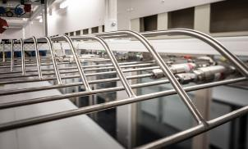
Dave’s Background
8 Years @ Air Liquide North America
  Cryogenic engineering, project & operations management
  Hi-purity process system design & fabrication
8 Years @ Advanced Silicon Materials (ASiMI / REC ) Butte
  CVD Operations manager
  Director, R&D
5 Years – Plant Manager; Lattice Materials Bozeman
4 years – Silicon Manufacturing & Sourcing Solutions (SiMASS)
3 Years – COO; Qatar Solar Technologies (QSTec)
3 Years - MMEC

Slide 95
Problem Statement
Problem: The system is in place but you don’t have any idea of how it is performing relative to your business strategy.
Where are your opportunities to improve the system?
Are your resources allocated correctly?
Where are you saving or losing money?

Slide 96
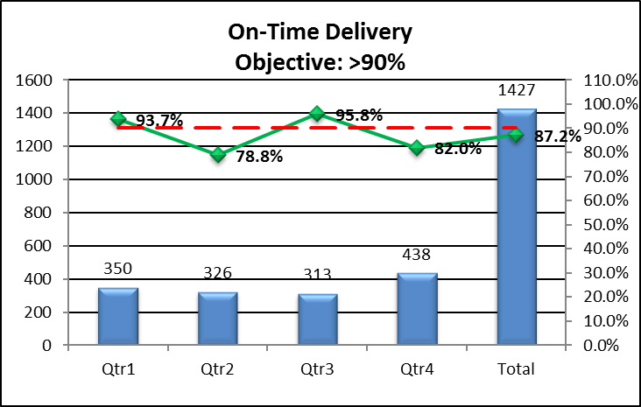
Collect and Analyze Data
Solution: Establish measurements systems
On-Time Delivery
Warranty Returns
Customer Perception
Manufacturing Yields
Scrap costs
Product build times
Effect:
Clear understanding of strengths and weaknesses of the organization
Data available for decision making

Slide 97
Observe Your System
Solution: Have personnel assess the system
Are personnel following the processes as designed and documented?
Are there processes that can be improved?
Effect:
Information available for decision making
Personnel have a voice in the system therefore greater buy-in

Slide 98
Management Review
Solution: Monthly/Quarterly Review with Senior Management
  Status of the System
  Process and Product Data
  Results of the assessment of your system (observations)
  Status of customer perception
  Status of improvement efforts
Effect:
Better understanding of the performance of the system
Know where to focus resources for improvement efforts
Determine and assign actions
Confidence that the system is meeting your strategic goals and saving money

Slide 99
Questions to Ask Yourself
?
Do you know how long it takes to build your product?
Do you know what percentage of your products are shipped on time?
Do you know what percentage of your products are returned from your customers?
Do you know your material scrap cost?
Do you know whether or not your customers are happy with your products?
Know where you are to know where you’re going

Slide 100
Checklist of Core Supplies for the Journey
Design Process, New Product Introduction process
Manufacturing Flow (Map)
Document Management Process
Engineering Change Control Process
Equipment Management Process
Discrepant Material Process
Service Return Process
Supplier Management Process
Training Process
Problem Solving Process
System Monitoring Process
Checklist Complete!

Slide 101
LUNCH
Food

Slide 102
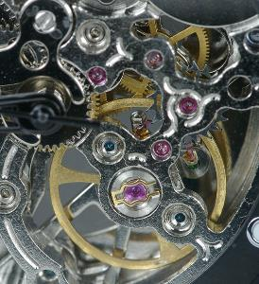
The system:
Putting it all together
Ben Klein
Quality Manager
FLIR Systems, Inc.

Slide 103
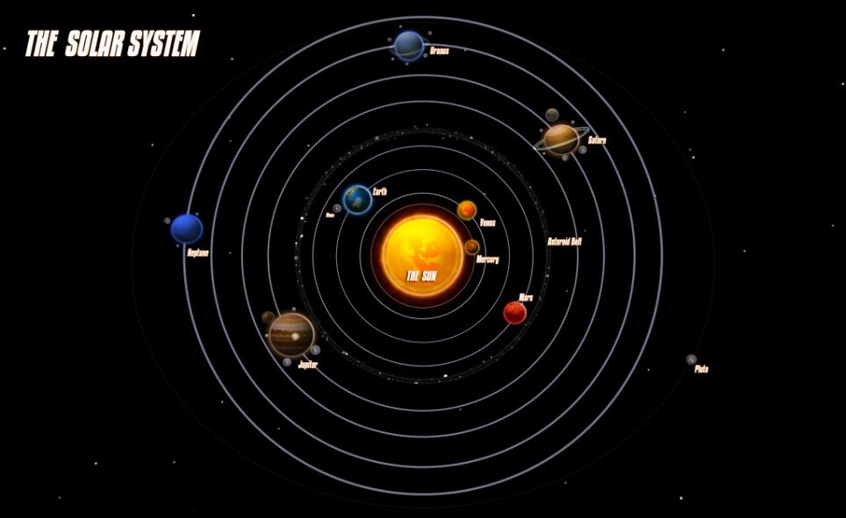
Design and R&D Processes

Slide 104
Manufacturing Flow
Design and NPI Processes
Engineering Change Control
Document Management
Equipment Management Process
Discrepant Material Service Return Process
Training Process
RCCA Problem Solving Process
System Monitoring Process
Supplier Management Process

Slide 105


Quality Management System
Quality Management System is a set of policies, processes, and procedures that direct and organize activities to meet the needs of the customer.

Slide 106
Why Implement a Quality Management System?
To mitigate risk
To ensure consistent quality product to your customers
To meet the needs of the customer
To meet the needs of your personnel
To organize your organization
To improve your products
To improve your future designs
To improve your processes
To make your organization scalable
To save money by reducing costs
Implementing a Quality Management System becomes one of your core business strategies

Slide 107
How it all works as a system (EXAMPLE)
At the quarterly management review (Management Review Process)
  noticed a trend in increasing warranty returns in Q3 (Warranty Return Process, Data Analysis)
Initiated a Corrective Action (RCCA Process)
  Root Cause: Design problem with the lens
  Solution: Change the lens design
Initiated an Engineering Change Order to improve design of the lens (ECO Process)
  Released Rev B of the drawing for the lens
Made it easier for the supplier to manufacture (Supplier Partnership)
Revised work instructions to Rev B (to use tweezers when handling lenses) (Doc Control)
Trained techs on improved handling techniques (Training Process)
Result: warranty returns decreased in Q4
Eight processes!

Slide 108

Leave behind a trail of records
How did we get here?
  Trace the system by following the trail of records. This is called Identification and traceability.
Examples
Corrective Action Number (CAR, CAPA, RCCA)
Service Return Number (RMA)
Discrepant Material Number (DMR)
Engineering Change Order Number (ECO)
Document Number
Part Number
Serial Number
Lot Number
A trail of records is your path for investigating causes. It weaves your processes together.

Slide 109
Resource Allocation Strategies for a QMS
Quality Manager
  Responsible for implementing an maintaining the QMS
  Can operate independent of production demands
  Not department specific. Neutral
Process Owners
  Responsible for the design and control of the process
  Is accountable for the success of the process
Process Coordinators
  Responsible for ensuring the process runs according to procedure
  Works in the trenches guiding the process

Slide 110
Multiple hats
Process Coordinator Examples
Administrative Assistant: Document Control Coordinator
Incoming Inspector or MFE: Calibration Coordinator, Preventive Maintenance
Buyer or MFE: Supplier qualification and data
Production Manager: Discrepant Material Process Coordinator
Planner: Service Return Process Coordinator
Supervisors: Maintain respective training records
Internal Auditors: Assembly tech, buyer, admin
“Quality is everyone’s responsibility!”
-W. Edwards Deming

Slide 111

Core Elements of a Quality Management System
Design Process, New Product Introduction process
Manufacturing Flow (Map)
Document Management process
Engineering Change Control Process
Equipment Management Process
Discrepant Material Process
Customer service
Supplier Management
Train Personnel
Problem Solving Process
System Monitoring Process
Where can you find this checklist?

Slide 112
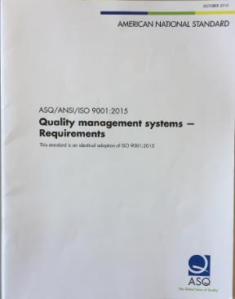
ISO 9001 International Standard
Design Process, New Product Introduction process
Manufacturing Flow (Map)
Document Management process
Engineering Change Control Process
Equipment Management Process
Discrepant Material Process
Customer service
Supplier Management
Train Personnel
Problem Solving Process
System Monitoring Process

Slide 113
Discipline vs Conformance
The basic concept of ISO 9001
Say what you do
Do what you say
Prove it
Improve it
Discipline to follow the process
Integrity to do what you say you’re going to do
If you have implemented the processes (Say)
If you are following the processes (Do)
If you are proving it to yourself that they work (Prove)
If you making them better (Improve)
Then you will be in conformance with the standard!
Certification follows naturally.

Slide 114

Regarding Resources
Resource Appendix
  Trainers with contact information
  MPIA website
MMEC courses (Examples)
  Understanding ISO 9001:2015
  Internal Quality Audit training
  Root Cause Analysis
  Lean Manufacturing

Slide 115

Summary
Practical approach to implementing a system of processes
Discipline to follow processes (Discipline rather than Conformance)
Quality Management System is a system of processes
A QMS as a key business strategy (necessary and attainable)
ISO 9001 is simply a checklist of processes for a complete QMS

Slide 116

Open Forum
Q&A

Slide 117
Appendix A: Resources
MPIA Website
http://www.montanaphotonics.org/
http://www.montanaphotonics.org/quality-alliance/
Montana Manufacturing Extension Center
http://www.montana.edu/mmec/
Trainers | Company | Role | Email
Ben Klein | FLIR Systems Inc. | Quality Manager | benjamin.klein@flir.com
Daniel Juliano | MSU Technology Transfer Office | Director | daniel.juliano@montana.edu
John Malachowski | FLIR Systems Inc. | Manufacturing Manager | john.malachowski@flir.com
Mary Johnson | Wavelength Electronics | CEO | mary@teamwavelength.com
Steve Birrell | Quantum Composers | CEO | sbirrell@quantumcomposers.com
Kim Rollefson | Quantel/Lumibird | Quality Manager | KRollefson@quantelusa.com
Conlin Ritter | Quantel/Lumibird | Quality Manager | conlin.ritter@gmail.com
Robert Martin | Auto Pilot | Quality Manager | rmartin@autopilotdesign.com
Kurt Borge | Quality Time Montana | Quality Consultant | qtm@q.com
Dave Allard | MMEC | Sr Manufacturing Process Engineer | david.allard1@montana.edu

Slide 118
Appendix B: Quality Principles
Customer Focus
  Understand and fulfill customer
    Requirements
    Expectations
    Needs
  Repeat customers
  Increased customers
Leadership
  Provide unity of purpose (vision, mission)
  Establish strategy
  Provide conditions for success
Engagement of People
  Involve personnel in the process
  Provide a voice
  Encourage commitment to the system
Process approach
  Consistent and predictable results
  Improved effectiveness and efficiency
  Systems thinking
Improvement
  Evolution of processes
  Decrease cost: increase effectiveness and efficiency
Evidence-based decision making
  Collect evidence and data to formulate decisions
  Reduce uncertainty
  Leads to greater objectivity
Relationship management
  Customers
  Suppliers
  Personnel
  Community
ISO 9000
A system of processes is a network of relationships.

