Slide 1

Training Process
Mary Johnson
CEO
Wavelength Electronics

Slide 2
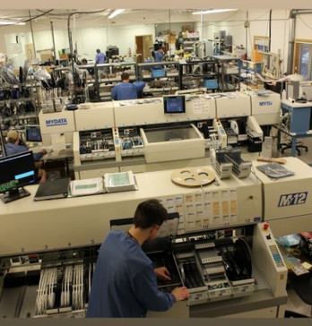
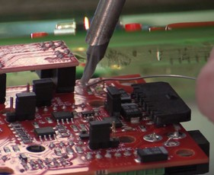
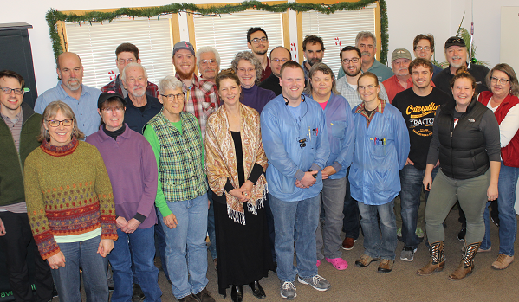
WEI Electronic Assembly Staff
Electronic Assembly Staff
What questions to ask...
Buyers
Receiving
Schedulers
Manufacturing Engineers
SMT operators
Selective solder operators
Hand assemblers
Testers
Technicians to rework & troubleshoot
Final packagers
Shipping clerks
Notes:
Who is Wavelength
Wavelength Electronics Inc. was founded in 1992 by husband and wife Chuck & Mary Knighton. Chuck is now Chief Technical Officer and Mary is CEO. Both have degrees in Electrical Engineering.
Wavelength is a privately held corporation.
Early on, only instrumentation was available for operating laser diodes and thermoelectrics. We saw an opportunity to offer the technology packaged as components and modules. We have successfully tapped several markets averaging 26% growth annually.
In short, Wavelength simplifies advanced control technology so innovative tool developers with limited electronic design resources can achieve cutting edge performance.
Our technology platform currently consists of high performance temperature controllers and laser diode drivers.
Temperature Control == best commercially available temperature stability 0.001°C
Laser Diode Drivers == lowest noise, most stable current source ???
The high performance platform is accompanied by innovative packaging that makes the technology easy to use
R&D works with various universities on core control technology research. We will be introducing a new control technology this summer.
Thorough, Reliable, Responsive Technical Support is key to establishing the position of authority & knowledge with customers.
We have developed sophisticated web based tools to enhance technical support. These include searchable FAQs, design calculators, and technical and application notes.
We have a facility in Bozeman, Montana, USA. Services includes sales and technical support, engineering, and low volume / high mix manufacturing. High volume manufacturing is sub-contracted.
Our primary success has been with these markets: electro-optics, semiconductor manufacturing, bio-medical, military, research and university. We have had some success with the fiber optic and telecom markets and want to team with Richardson to more thoroughly serve these customers.

Slide 3

Training Process Evolution
What questions to ask...
Problem: Sales have increased! I can’t do it alone...
Solution: Hire employee #2, train them
Training looks like building together, one-on-one
Gather the right tools to make the work more efficient
Break down the assembly steps so each person can do a piece & it gets faster & more consistent (specializing)

Slide 4

Training Process Evolution
What questions to ask...
Problem: Company is growing! I don’t have time to train!
Solution: Employee #2 trains employees # 3, 4, 5
To make sure the right stuff is communicated, write up a training document – For WEI, that’s an Assembly Ticket
Train Employee #2 to train correctly
Establish time standards & workmanship standards & measure

Slide 5
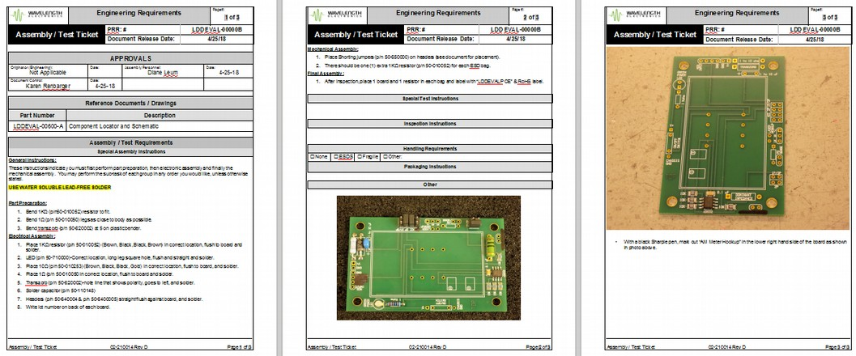
Example Assembly Ticket
a.k.a. Work Instruction
What questions to ask...
Example Assembly Ticket

Slide 6
Training Process Evolves
Problem: Sales have increased! RMAs, too...
One widget takes 0.5 hours to build & 3 hours per RMA—so RMA’s are very expensive to deal with
Solution: Root cause analysis & retraining
Edit Assembly Ticket to avoid failures
Develop training content plan so Trainer knows what to cover
Develop training record forms to know who is trained to do what
Look for industry standard training – IPC for electronics

Slide 7
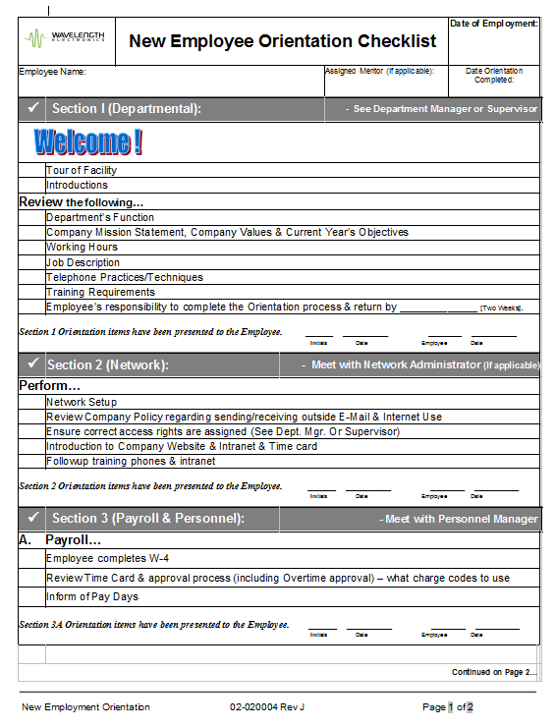
Training Record Example
Training Record – Example
Training Records - Examples
Training Requirements on New Employee Orientation form
IT
HR forms
Safety

Slide 8
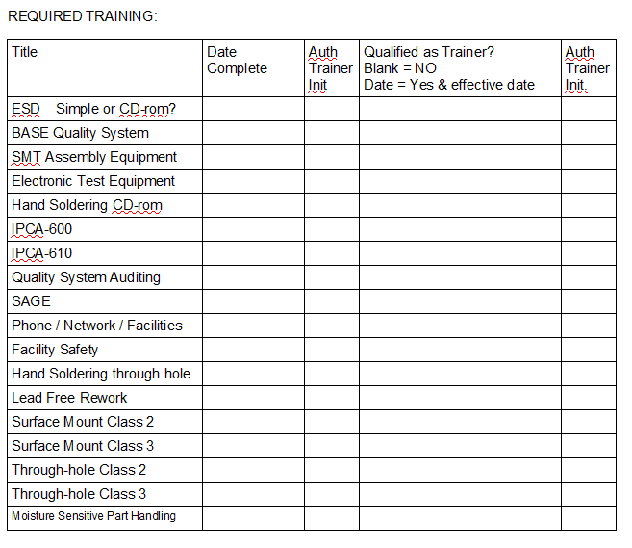
Training Record Example
Training Record Example
Training Records - Examples
Training Requirements Matrix on Job Description
IPC training – ESD prevention, soldering, inspection, component ID
BASE Quality System
Equipment knowledge relevant to the job
Training done & Trainer status recorded on Job Description

Slide 9
Training Process Evolves
Training Process Evolves
Problem: Key employees leave: lose 25 years experience
How much knowledge is written down?
Solution: Hire right, train thoroughly, measure basics
Edit Assembly Tickets to document everything possible before key employees leave
Hire conscientious people, train, measure First Pass Yield, do root cause analysis on failures, let them learn & improve
Cross train

Slide 10
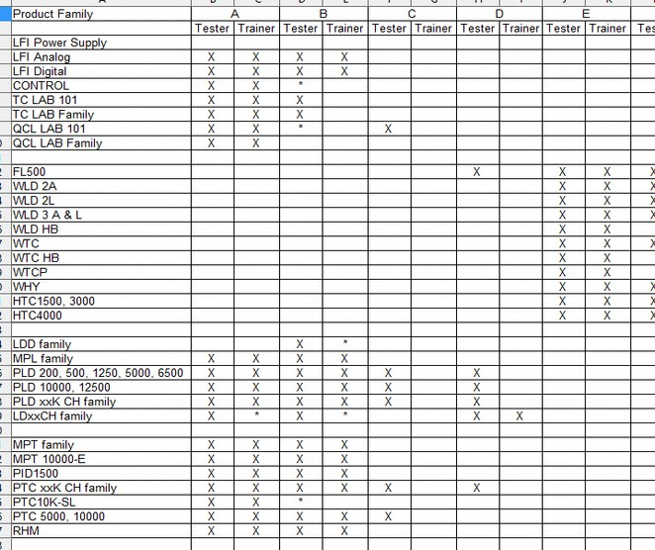
Training Record – Cross Training
Training Record – Cross Training
Cross Training Log

Slide 11
?
What Questions to Ask?
Questions to Ask Yourself
Cross Training Log
What questions to ask...
Do you know how to build your widget?
Do you know how to teach someone else to build it?
Do you know how to teach someone to train someone else to build it?
Do you know if the person building it has been trained?
Do you know if their training was adequate & recent?
Is the team able to handle absences?
If someone leaves, can someone else do their job?
Have you ever had a problem because of lack of training?
Create a Learning Organization

