Slide 1

Supplier management
MPIA Quality Alliance Webinar Series
Presented by Kurt Borge
May 18, 2022

Slide 2
This is what you will learn
Why supplier management is important
Why supplier quality is your responsibility
The supplier management process
How to select and qualify suppliers
How to verify and monitor supplier quality

Slide 3
Why Supplier Management is Important
Proactive supplier management provides you with high quality materials, components, and services.
Poor incoming quality costs time and money, as you compensate with rework, deviations, delays and returns.
A robust supplier management program will reduce the risk of supplier issues.
This begins with your planning & communications.

Slide 4
SUPPLIER MANAGEMENT PROCESS

Slide 5
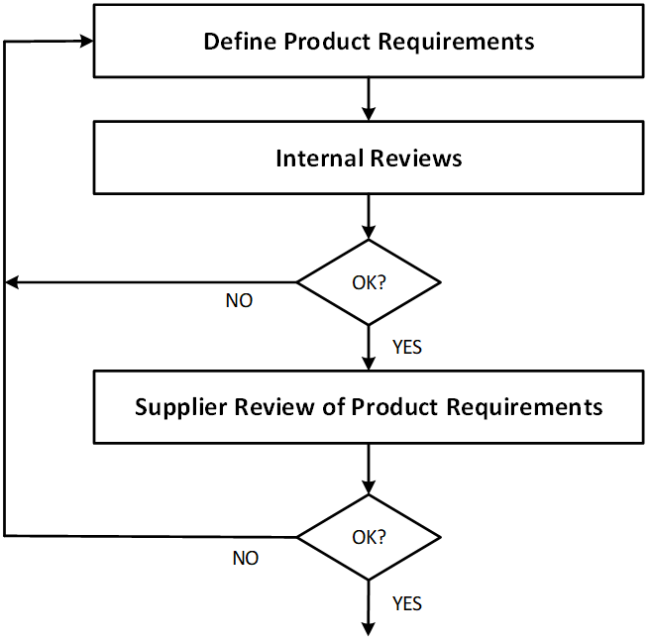

Typical supplier management process

Slide 6
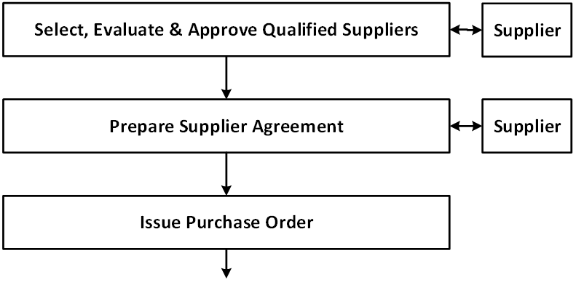


Slide 7
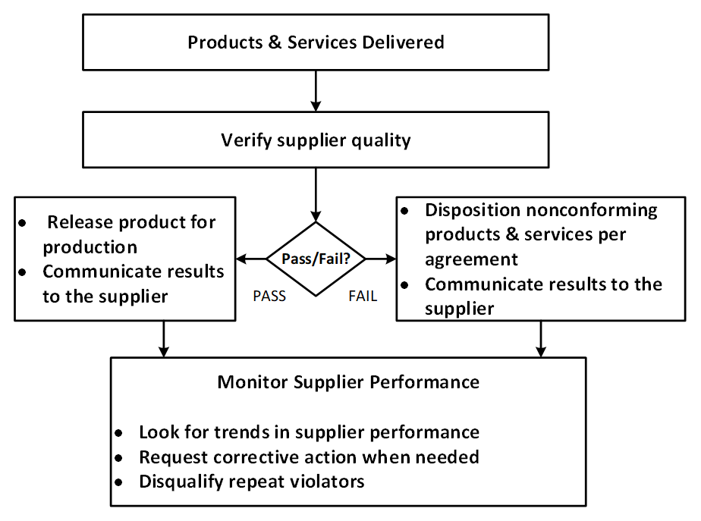



Slide 8
SUPPLIER MANAGEMENT ELEMENTS

Slide 9
Define your product requirements
Design – strength, materials, purities, etc.
Processes – heat treating, coating, etc.
Industry standards – electrical, material, etc.
Regulatory – FDA, FAA, etc.
Testing and inspection.
Installation, servicing and maintenance.
Storage, packaging and shipping.
Worker skills and certifications (e.g. soldering & welding).
Other requirements known to you, but may not be apparent to your supplier.

Slide 10

Supplier selection, evaluation and qualification
Can the supplier provide you the products and services that meet your requirements?
Is the supplier reliable: Will the supplier reduce, or increase, your overall risk?
Notes:
VLC example of using a broker to manufacture printers

Slide 11

Supplier selection & evaluation
Identify potential suppliers.
Evaluation methods may include:
  supplier questionnaires
  review of supplier procedures
  on-site visit or audit
  product sample evaluation
  Quality Management System certification.
Notes:
* Printer example – didn’t qualify the suppliers

Slide 12
Typical questions to ask your supplier
How do you handle your nonconforming material?
Do you have a training program?
How do you qualify your suppliers?
How do you control your ‘special processes’?
Do you have appropriate testing and inspection abilities?
Are your measuring & testing instruments calibrated?
What is your internal change control process?

Slide 13
Approve qualified suppliers
Approve your suppliers based on their ability to meet your requirements and reduce your risk.
Use multiple suppliers when possible to avoid sole-sourcing.
Maintain an approved suppliers list.
Also:
Consider “grandfathering in” proven suppliers.
Consider re-qualifying suppliers if they haven’t been used for a period of time.
Have criteria for disqualifying suppliers.

Slide 14

Supplier agreements may be useful
Nonconforming material (NCM) resolution process.
Acceptable Quality Levels (AQLs) and sampling plans.
Notifications – if the supplier changes their process or ingredients.
Safety stock and purchase minimums.
Responsibilities.
Contacts.
Confidentiality agreements.
Notes:
Again, it all depends on the level of control you need.

Slide 15
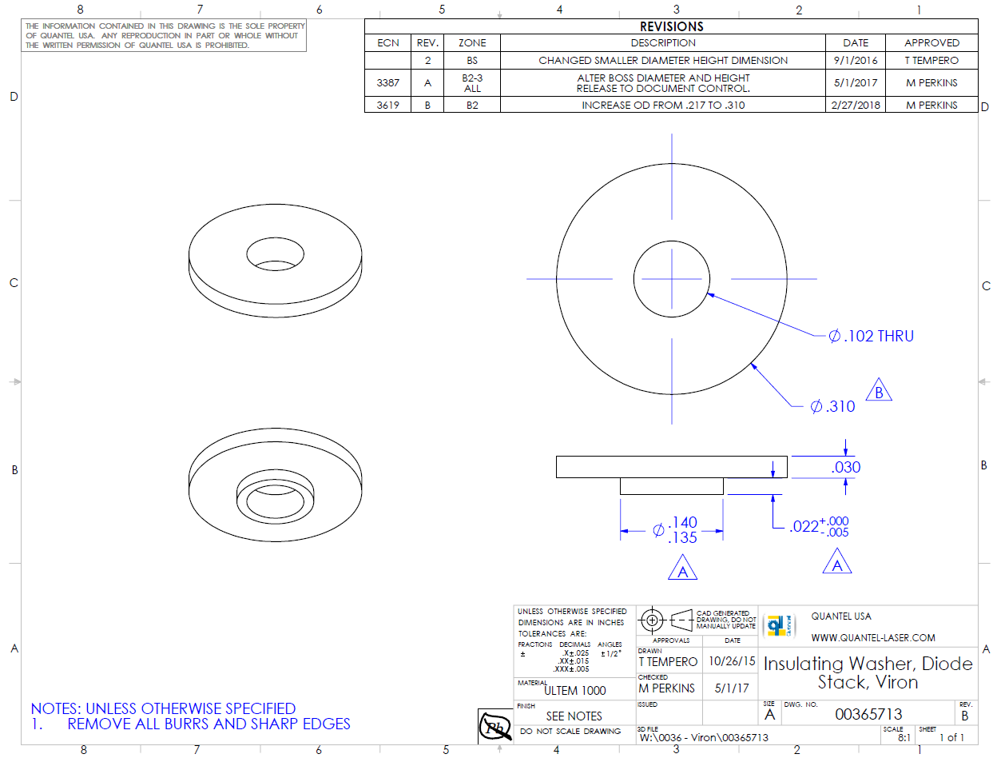
Purchase documents
Incorporate your requirements into:
specifications
drawings and blueprints
bills of materials
instructions
supplier agreements
delivery
Reference these requirements in purchase orders.

Slide 16
Verify supplier quality
Incoming tests and inspections.
Follow agreed to acceptance criteria.
Quality may be verified at the supplier’s site.
Certificates of compliance, e.g. material certs.
Consider using industry standard sampling plans to speed things up.

Slide 17

Monitoring Supplier Performance
Periodically review supplier performance and look for trends in:
Testing & inspection data
On-time delivery information
Responsiveness
Anything else important to your success.
Request corrective action when needed.
Notes:
If you rely on supplier testing and inspections, do spot or sample inspection

Slide 18
Importance of good supplier relationships and communications
If the supplier doesn’t know about a problem, they will assume the quality they sent you was adequate.
Establish contacts for reporting and resolving issues.
Communicate good and bad quality to your supplier, and in a timely manner.
Keep in mind: many supplier quality problems begin on your side, by not providing adequate or correct information.

Slide 19

Conclusions
A proactive supplier management system will help provide you with high quality materials, components, and services.
Supplier quality is your responsibility, built on good planning and communications.
Build relationships with your suppliers, making them partners in your success.

Slide 20
MPQA Quality Alliance Contact Information
MPIA Website
https://www.montanaphotonics.org/
MPIA Quality Alliance
https://www.montanaphotonics.org/quality-alliance/
Trainers | Company | Role | Email
Ben Klein | FLIR Systems Inc. | Quality Manager | benjamin.klein@flir.com
Daniel Juliano | MSU Technology Transfer Office | Director | daniel.juliano@montana.edu
John Malachowski | FLIR Systems Inc. | Manufacturing Manager | john.malachowski@flir.com
Mary Johnson | Wavelength Electronics | CEO | mary@teamwavelength.com
Steve Birrell | Quantum Composers | CEO | sbirrell@quantumcomposers.com
Conlin Ritter | Quantel/Lumibird | Quality Manager | conlin.ritter@gmail.com
Kurt Borge | Quality Time Montana | Quality Consultant | QualityTimeMontana@gmail.com

