Slide 1
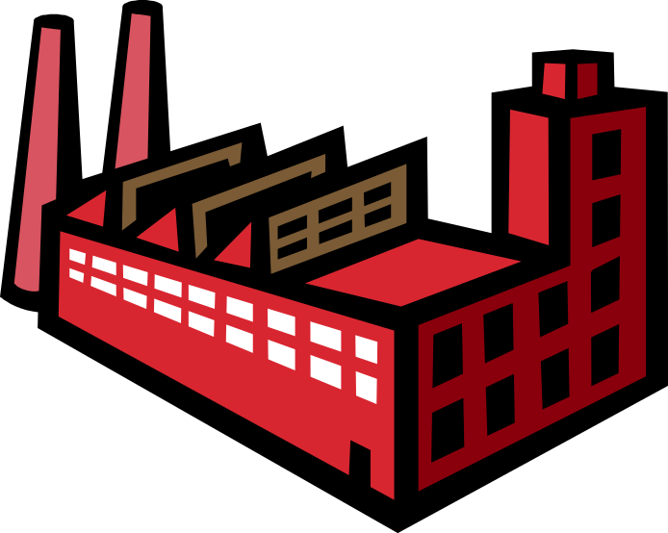


Manufacturing Flow
John Malachowski
Manufacturing Manager
14 years
15 years

Slide 2


Challenge: Manufacturing Flow
Problem: There is an abundance of work-in-process, but an absence of finished-goods inventory
Customers calling about late shipments and the ones that do arrive do not meet all specs
Customers are beginning to lose trust in our ability to meet their expectations
Manufacturing team unable to repeatably produce high-quality lasers on time
Qty Work in Process = 5
Qty Ready to Ship = 0

Slide 3
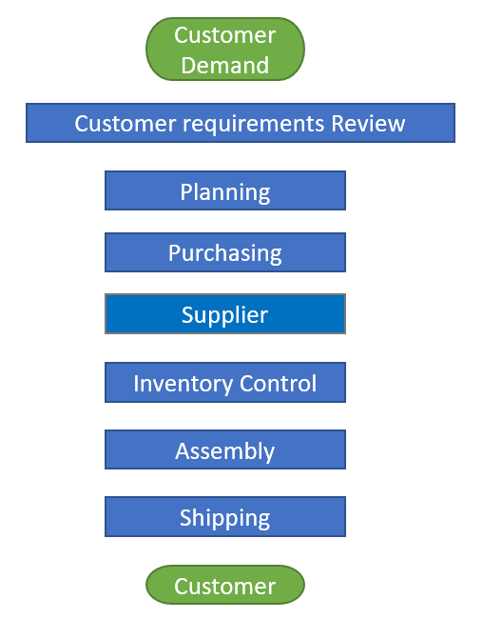
Establish Manufacturing Process to Create Flow
Solution: Design a process that produces lasers that meet the customer’s expectations of quality and delivery
Confidence is high that we can meet the customers’ expectations when they engage our company
All production demands are assessed and produced utilizing a disciplined manufacturing process
All customer expectations are met resulting in increased customer confidence and increased sales
Make good decisions weighing both customer expectations and organizational capabilities
Accurately allocate manufacturing resources to meet customer expectations
Manage materials acquisition to meet production demands
Establish partnership relationship with suppliers based on quality, cost and on-time delivery
Repeatable methods of controlling materials throughout entire manufacturing process
Establish standard work instructions/flow that recognize the value of design, fixtures, and trainable techniques and procedures.
Ensure that all customer expectations are met prior to any product leaving the facility.

Slide 4
Manufacturing Concepts
WORKPLACE CULTURE
CUSTOMER SERVICE
PROCESS TIME
TOYOTA PRODUCTION SYSTEM
WORLD-CLASS MANUFACTURING PROCESS
STANDARD WORK
THEORY OF CONSTRAINTS
LEARNING ORGANIZATION
DESIGN FOR MANUFACTURABILITY
LEAN
LABOR CAPACITY
VISUAL MANAGEMENT
LEAD TIME
RESOURCE MANAGEMENT
MATERIAL CONTROL
PROCESS DISCIPLINE
OPERATIONAL EXCELLENCE
Pursue manufacturing concepts to create excellence!

Slide 5
?
Questions to Ask Yourself
Are you Over Producing?
Do you have the right inventory?
Do your operators/techs find themselves waiting?
Does your material flow in the shortest path?
Do your take unnecessary steps or movements?
Are you doing more than necessary to meet customer expectations?
Are you struggling with quality / defects?
Are you fully utilizing your talent?
Understanding these questions is your first step on the path to Lean Manufacturing

