Slide 1
Discrepant Material Process
MPIA Quality Alliance Webinar Series
Presenter: Ben Klein
Notes:
Welcome to the fourth webinar in a series of quality-related webinars presented by the MPIA Quality Alliance a sub-committee of the Montana Photonics Industry Alliance in Bozeman, Montana. Thank you for joining us.
My name is Ben Klein. I’m the Quality Manager for Teledyne FLIR Surveillance, Inc in Bozeman, Montana
The subject of this webinar is the Discrepant Material Process. One of the most critical processes to manufacturing flow.

Slide 2

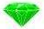


Agenda: This is what you will learn
What is a Discrepant Material Process?
Why is the Discrepant Material process invaluable to the flow of manufacturing?
How to implement a Discrepant Material process, what can I do right now?
How does the discrepant Material process lead to improving the organization?
Notes:
Agenda
In this presentation you’ll learn
What a Discrepant Material Process is
Why it is so valuable to the flow of manufacturing
A few easy steps for how to implement this process in your organization.
How the Discrepant Material Process leads to improving your system

Slide 3


What is the Discrepant Material Process
The Discrepant Material Process is the process for managing discrepant material to minimize the impact to the flow of manufacturing.
Discrepant material can occur anywhere in a manufacturing process: Incoming inspection to shipment of final product
Incoming Inspection
Assembly
Final Testing
Notes:
Gem 1: What is a Discrepant Material Process
Imagine a race car getting a flat tire during a race. It pulls off the track into the pitstop. The pit crew quickly removes the wheel with flat tire, places a new wheel with a fresh tire on the vehicle, and gets the vehicle and driver back on the track. The pit crew then studies the flat tire to try to figure out why it happened. That is, what might have caused the flat? And determines what to do with the flat tire?
Remove the tire from the rim and put a new one on?
Patch the tire and try to use it again?
Scrap both the tire and the rim, maybe the rim is damaged?
Meanwhile, the car is still in the race. This is the Discrepant material process!
The Discrepant Material Process is the process for managing discrepant material to minimize the impact to the flow of manufacturing.
Discrepant material can occur anywhere in a manufacturing process. Generally it occurs during incoming inspection, assembly, and testing. Just as a flat tire can affect the performance and outcome of a race, the discrepant material can interfere with the performance and outcome of manufacturing.

Slide 4
Definition of Discrepant
Discrepant Material – Generally means nonconforming
Nonconforming – Does not meet specification as defined by a drawing
Questionable
  Parts don’t fit
  Wrong color
Discrepant material includes
Parts/Material you purchase
Sub-assemblies you build
Final product that fails during testing
Notes:
What is discrepant material
Discrepant generally means nonconforming, where nonconforming means it does not meet specification as defined by a drawing or print.
For example, a chip or scratch in an optic that doesn’t meet surface quality spec, dimensions on metal parts that don’t meet spec, a failed PCB.
However, it can also mean material, parts, components that are questionable in some manner. Two conforming parts that don’t fit together due to tolerance stack up is discrepant
For example, a scenario where an optic doesn’t fit in the housing even though the dimensions for both parts are in spec. Or you notice that the coating on a batch of optics you just purchased has a different color, a slightly different tint than what you’re used to seeing.
All of these are considered a discrepant material event.
Discrepant material includes:
Parts/Material you have purchased,
Sub-assemblies you are trying to build
Final product that fails during final acceptance testing
In a complex, sensitive, non-linear, or high-fluence photonics product, it’s a good idea to question nonconforming or questionable material and set them aside for further evaluation rather than take the risk of using it in your product.

Slide 5



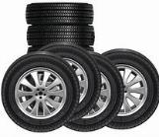
Why is the Discrepant Material Process invaluable to Manufacturing Flow?
  Improves Efficiency
    Removes and replaces material quickly
  Mitigates Risk
    Prevents disruption of downstream flow
    Decrease material cost
    Prevents disruption of production schedules
    Prevents customer returns
  Facilitates Communication
    Need a new part
    Tell the vendor
    Update/replenish inventory
    Update the customer
I need a new part!
No problem
Shop floor
Stockroom
Notes:
Gem 2: Why is the Discrepant Material process invaluable to Manufacturing Flow
Even if you’ve developed the most effective processes, documented them as clearly as possible, have a low-risk, elegant design with highly tuned tolerances, well-trained, skillful technicians, with a keen sense of detail and curiosity, a trusted partnership with top-notch suppliers, you will encounter discrepant material. Therefore it is essential to design and implement a good process for managing discrepant material
This process is a solution to a problem you will face while manufacturing your product
The Discrepant Material process is invaluable to manufacturing because, Improves the efficiency, Mitigates Risk, Serves as a vehicle for communication
Improves Efficiency of the manufacturing process
A good discrepant material process improves the efficiency of the manufacturing process because it quickly removes and replaces discrepant material so you can keep manufacturing flowing rather than spending time trying to fix a bad part. In the racecar analogy, you don’t want your driver to step out of the race and begin trying to fix the flat, trying to figure out why it became flat, and then spending valuable time looking for a replacement all while the race is going on.
The same is true for your technician. Discrepant material is purely an obstacle. It interferes with the ability to perform the key function of assembly. So the Discrepant Material Process improves the efficiency by:
Quickly removing the discrepant part from manufacturing flow
Preventing wasted time through “rework on the fly”
Quickly replacing discrepant material with new material so assembly processes can continue
The Discrepant Material Process Mitigates Risk
Prevents disruption of downstream flow
You prevent the material from being accidentally incorporated into other products, which could cause additional problems, possibly bigger problems, later in the assembly process.
Reduces the risk to the cost of material and labor
If technicians have to spend time trying to fix a part before they use it, then your labor cost will increase. Or if you have to continuously replace parts, your material costs increase. In either case, the cost of your product increases and decreases your margin.
Reduces the risk to the production and delivery schedule
Time spent trying to fix a bad part or trying to find a good part is time not spent building to schedule
Reduces the risk of bad product reaching the customer resulting in returns
Generally speaking, a bad part will prevent your product from working before you even ship it to the customer. However, a bad part may result in latent failure of your product once it’s in the field, in use with your customer. This can have a huge impact to your reputation.
Facilitates Communication
The Discrepant Material Process serves as a vehicle for communicating that a new part is needed
Tell the Vendor
If discrepant material is discovered during incoming inspection, then you can use it to communicates to the vendor that there is an issue with their part.
Update Inventory
If the discrepant material occurs during assembly, then it notifies the stock room the replacement is needed. Now the stockroom can update the inventory count and can replenish inventory.
Update Customer
If the discrepant material is significant enough, you may want to communicate to the customer that delivery schedules may be at risk.
In conclusion, the Discrepant Material Process improves efficiency, mitigates risk, and facilitates communication.

Slide 6

Process Implementation
Three Primary Steps
1
2
3
Identify and Document
Label, capture information, segregate when possible
Evaluate
Review the information to determine disposition of the discrepant material. (what are we going to do with it)?
Perform Disposition
Disposition the material based on evaluation.
Notes:
Gem 3: Process Implementation
Implementing a Discrepant Material process is fairly straightforward. There are many solutions to solve the problem of how to manage discrepant material. Most of them, you will find, have common approaches and similar steps. The solution provided here will hopefully give you what you’re looking for or at least give you ideas for how to implement a process best suited to your organization. As you will see, with the solution we are providing in this presentation, you can use basic, low-cost tools that are likely already at your disposal that are quite effective.
The overview of this process can be broken down into three primary top-level steps:
Identify and document the discrepant material
Evaluate the information regarding the discrepancy to determine disposition
Perform the disposition

Slide 7
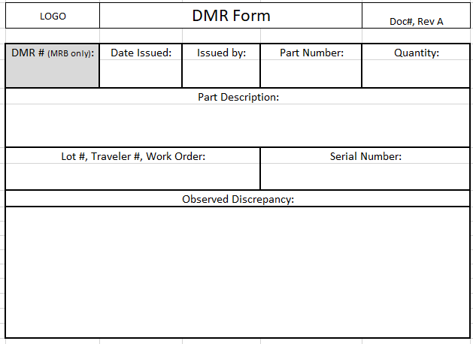
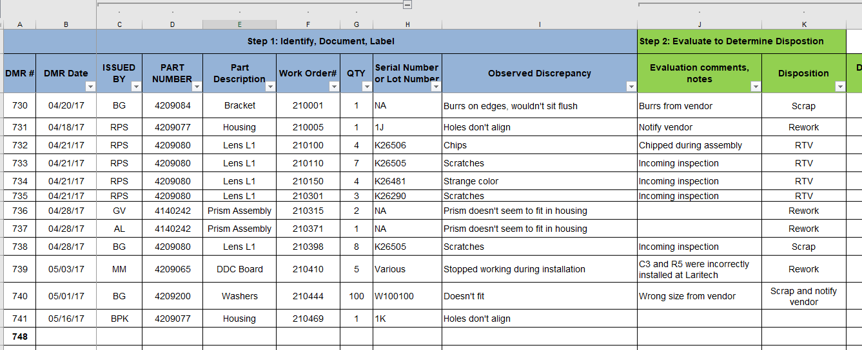
Step 1: Identify and Document
Rejected
DMR# 21404
Part#: 4121771
Date: 9/18/2021
Name: Ed Deming
  Discrepant Material Log (Excel log/database)
  Discrepant Material Report Form
Notes:
Identify and Document
The first step when you encounter discrepant material is to identify it in some manner as discrepant using a label or a tag. The next step is to document key information about the discrepant material event. This includes basic information such as part number, serial number (as applicable), date, your name
It also includes sufficient description of the discrepancy and the nature of the discrepancy such as key factors and conditions in which it occurred.
For example, you might write: “There is a large scratch on the optic well within the clear aperture that occurred while trying to place it in the housing”
The best way to capture this information is on a form. This form is called a Discrepant Material Report or a DMR.
The information from the DMR is then logged in a spreadsheet or database. We call this the DMR Log. Each entry has a DMR# to uniquely identify the DMR event. You’ll see later how capturing and compiling this information can lead to improving your system. This log also serves the key function of tracking the discrepant material throughout the process so it isn’t lost or forgotten. Finally, the log serves as a history to help you determine what to do with the part based on what you did last time.

Slide 8
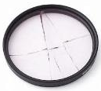
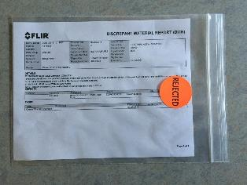
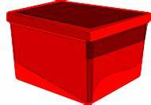
Tools and Equipment to Segregate
Bins, Bags, Labels
Discrepant Material
Discrepant Material bin
Klein Lasers, Inc.
Discrepant
DMR inside bag
Notes:
Tools and Equipment
Labeling or tagging a discrepant part may not be possible if the parts are too small or delicate. Here is a solution that you can consider:
If you can’t tag the part, tag a bag, and put the part in the bag. Label the bags with a sticker that states “reject” or “discrepant”. This identifies the parts as being no good.
After you’ve completed a DMR form, you can place it into the bag with the part. Now the part is clearly identified as discrepant, you know exactly what part it is, and it has the associated information that will make it easier for those who have to evaluate it.
Place the bag with the part and DMR into a clearly marked bin. This bin ensures that the part is segregated away from good parts. The bin can collect all of the bad parts and be presented to the evaluation step of the process.

Slide 9


Step 2: Evaluation
Manufacturing
Engineering
Quality
Materials
Evaluate DMR to determine disposition.
Disposition is generally determined based on risk.
MRB: Evaluation is performed by the Material Review Board.
Discrepant
Notes:
Evaluation
The purpose of the evaluation step is to determine the disposition of the material; that is, what to do with the material based on the information provided on the DMR.
Disposition is generally determined based risk to the quality and reliability of the final product. It must also take into account several other factors such as risks to schedule and cost.
Evaluation is generally done by a group of people with knowledge, experience, and expertise to assess these risks. This group can include representatives from manufacturing, engineering, materials, purchasing, quality. We call this group the Material Review Board (MRB). The evaluation by MRB can occur formally by meeting regularly, say once a week to review the discrepant material in the bins and prepare them for disposition. This can also be done more informally on the fly based on the urgency and risks. In any case, the disposition of the material also gets documented in the DMR Log which indicates that it has passed through this fundamental step.

Slide 10
Step 3: Perform Disposition
Use As Is
Rework/Repair
Scrap
Return to Vendor
Notes:
Disposition
The final step is to perform the disposition based on the decisions made by MRB.
Disposition generally falls into one of four categories
Use as is – return it to stock or back to floor so it can be used again
Rework/Repair – initiate work to rework or repair the item
Return to Supplier – Send it back to your supplier so they can assess it and then rework, repair, or replace as necessary.
Scrap – throw it away or destroy it in some manner
Three easy steps:
Identify and document, evaluate to determine disposition, perform the disposition

Slide 11


Improvement Through Data
Trends in DMR data lead to improvement
Focus improvement efforts on highest risk (Quantity, cost, schedule, quality)
Three basic areas of improvement
Process
Design
Supplier
Root Cause Analysis
Qty, Cost, Risk
Part Number
Notes:
Gem 4: Improvement Through Data
Finally, the discrepant material process is invaluable to manufacturing because it can help you improve your system.
Because you’ve logged the discrepant material, the information can be compiled and analyzed for patterns and trends. Generally this takes place in the form of a pareto charts. The X-axis is generally organized by part number. The Y-axis is based quantity of discrepant items, the number of discrepant material events, or the highest cost. One key way to evaluate discrepant material is to base it on the greatest impact or risk to manufacturing flow. A few 10 cent screws might not show up at the front of the pareto chart for quantity or cost, but this could result in high impact if it shuts down manufacturing.
This data, when organized, gives insight into:
Which parts are failing the most
Which failed parts are causing the biggest impact to schedule or cost to the organization
Which suppliers are providing the most discrepant parts. This log and the analysis can be used as a supplier performance metric as well.
Discrepant material can be deeply frustrating to a technician. So it is vital to understand which discrepant parts are affecting your organization the most so you can solve the problem and prevent this discrepant material from occurring again in the future. The Pareto charts gives direction for where to apply your resources to perform root cause analysis and ultimately to initiate improvement to your system.
For example, in the racecar analogy, if your front right tire becomes flat more often than any other tire, you know where to focus your attention.
Generally you’ll find that you will improve your system in three primary areas
Process
Design
Supplier
If the cause of the problem is your process, your methods or your tools, then you’ll want to revise your work instructions, your procedures, your forms, your tools, fixtures. It can include training personnel to be sure the current processes are understood or simply to continue to develop their skills and knowledge. Your personnel are key parts of the process.
If the cause of the problem is the design, you can work with engineering to improve the design to make it more manufacturable. Maybe the tolerances are too tight. Or the notes on the drawing are ambiguous or confusing. Having engineering improve the design will not only improve the manufacturability of your current products, it can provide invaluable lessons learned for future product designs.
If you determine the cause of the problem is the responsibility of the supplier, you can begin working with the supplier so they can improve their processes. Or it could serve as another mechanism to improve your design so the supplier can more easily make your parts. By working with your suppliers, you have the added benefit and opportunity to build better relationships with them.

Slide 12

Summary:
This is what you learned about the DMR Process
A solution for managing discrepant material throughout manufacturing.
Improves the efficiency of manufacturing, reduces risk, and facilitates communication.
Can easily be implemented in your organization using basic low-cost tools.
Improves the organization by identifying opportunities for improvement through data analysis
Notes:
Summary
Gem 1: The Discrepant Material process is the process for managing discrepant material throughout manufacturing.
Gem 2: The discrepant material process improves the efficiency of manufacturing, reduces risk, and serves as a vehicle of communication.
Gem 3: The Discrepant material process can easily be implemented in your organization using basic low-cost tools.
Gem 4: The discrepant Material process provides data that can be used to improve your system.
Implement this process in your system and help your organization take another step on the path of success!
For more information about this process, example templates, tools and ideas, please visit our website at https://www.montanaphotonics.org/
Thank you so much for your time.

Slide 13
Reference Information
Term | Definition
DMR | Discrepant Material Report. A form for capturing information regarding discrepant Material
DMR Log | A spreadsheet or database for compiling information about discrepant material and tracking it to closure.
MRB | Material Review Board. A team of people (generally subject matter experts) authorized to determine disposition of discrepant material.
Rework | Action on a nonconforming product to make it conform to the requirements (ISO 9000:2015 3.12.8)
Repair | Action on a nonconforming product to make it acceptable for the intended use (ISO 9000:2015 3.12.9)
Scrap | Action on a nonconforming product to preclude its originally intended use (ISO 9000:2015 3.12.10)

Slide 14
Contact Information
MPIA Website
https://www.montanaphotonics.org/
MPIA Quality Alliance
https://www.montanaphotonics.org/quality-alliance/
Trainers | Company | Role | Email
Ben Klein | FLIR Systems Inc. | Quality Manager | benjamin.klein@teledyneflir.com
Daniel Juliano | MSU Technology Transfer Office | Director | daniel.juliano@montana.edu
Mary Johnson | Wavelength Electronics | CEO | mary@teamwavelength.com
Steve Birrell | Quantum Composers | CEO | sbirrell@quantumcomposers.com
Conlin Ritter | Quantel/Lumibird | Quality Manager | conlin.ritter@gmail.com
Kurt Borge | Quality Time Montana | Quality Consultant | qtm@q.com
Matt McCune | Autopilot Inc. | Presidet | matt@autopilotdesign.com

