Slide 1
Engineering Change Order (Eco)
As part of Document Control
MPIA Quality Alliance Webinar Series
Presenter: Conlin Ritter

Slide 2



Agenda: This is what you will learn
What is Document Control and what makes it so important?
How do you implement a Document Control system?
How does a Document Control system lead to improvement in your product?

Slide 3
Common Problems:
Have you ever ordered the wrong revision part?
Have you built an assembly using the wrong type of materials?
Do you have failures in the field because a change designed to prevent an intermittent failure had not been implemented?
Are you struggling to figure out what the latest drawing/procedure is and where to get it?
Universal Solution: Document Control
Design a process to create, store, and make changes to information needed to build your product (Change/Engineering Control Process).
Notes:
Document control is all about risk mitigation – here are some common risks that it addresses.

Slide 4

What are the elements of good Document Control?
Documents stored in a safe central location – single source of truth
Everyone can view, but only designated person (Document Manager) has permissions to change documents
There is a process or tool to control change to documents
  Engineering Change Orders
Notes:
Document Manager cannot make changes alone – they need consensus on the change being made via an ECO

Slide 5

Engineering Change Order (ECO)
The process and tool to control change to your documents
Steps to ECO
  Identification for need of change
  Draft change
  Review & approve change
  Implement change
  Communicate change to relevant parties
Notes:
The ECO is the “meat and potatoes” of Document Control

Slide 6
1. Identify Need for Change
Production identifies manufacturing improvement – work instruction change
New supplier can provide higher capability optics, improving your product performance – product brochure change
Trend in RMAs or DMRs leads to design improvement – part drawing change

Slide 7
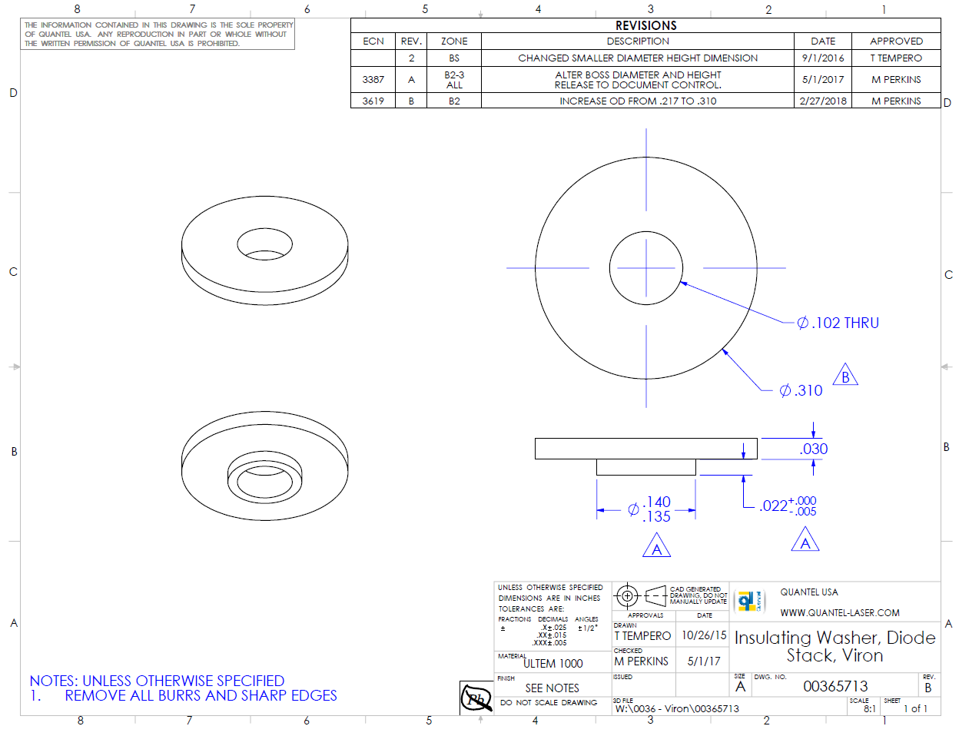
2. Draft Change
Revision History
Create change to document
  Highlight or track changes for ease of review
Update revision level
Save under ECO number identification
Title
Revision
Doc number

Slide 8
3. Review & Approve Change
Identify stakeholders based on scope of change
  Engineering, Production, Purchasing, Customer Service, Customer, Sales
Identify Change Impacts
  Will training need to be updated?
  Will Incoming QC Inspection Plans need to be updated?
  Will this be a Customer Service upgrade for already fielded systems?
  Do parts in stock, on the floor, and on order with a supplier need to be reworked? Scrapped? Used as is?
Communicate change & impacts to stakeholders
  Reason / need for change
  Description of change
  Draft of new version of document for review
Notes:
See slide 9 for how to communicate these details of the change and record approval.

Slide 9
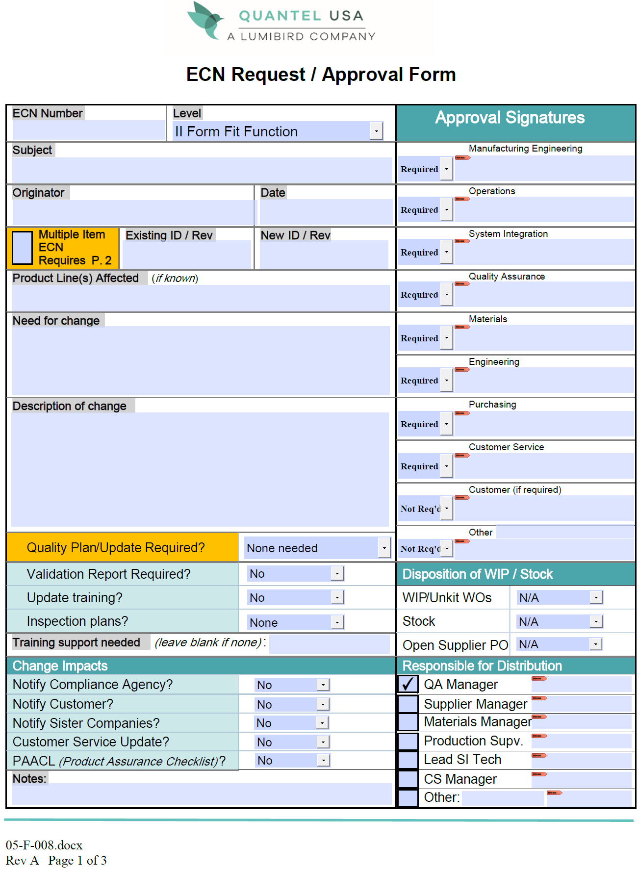
Notes:
This form was generated in Adobe Pro, with fillable fields and drop down options.

Slide 10
4. Implement Change
Move approved document to single source of truth location
Save old document in archive location (for customer service & engineering reference)
Update stock, WIP, Purchasing Info, Incoming QC Inspection Plans, Work Instructions, provide training, etc.

Slide 11
5. Communicate Change
Document Manager notifies all relevant employees of change
Purchasing notifies suppliers of change
ECO COMPLETE

Slide 12
ECO Summary Flowchart
Identify Need for Change
Draft Change
No
Review & Approve Change
Approved?
Change Cancelled?
No
Yes
Yes
Implement Change
No Change Made
Communicate Change

Slide 13
Document Control System
Should It Be Controlled?
Characteristics of Controlled Documents
Do you want it safe?
Do you want a record of changes?
Do you want everyone working to the same version?
Do you want to find it fast?
Document Title
Document Number
Revision Level
Process for making changes
Common Format
Revision History Table
Proprietary Statement
Stored in Document Library
  Central Location all can access
  Current Revisions
  Limited Edit Access
Examples of Controlled Documents:
Work Instructions
Specifications
Drawings
Procedures
Forms
Regulatory Requirements and Standards
Levels of Document Control
Rapid development and prototyping
  May only require engineering approval for changes
Higher volume production

Slide 14
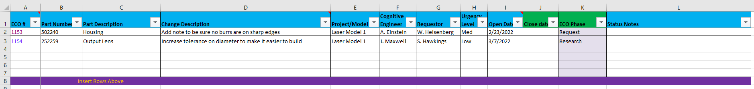
Options for getting started
1. ERP or software solution
2. Quick, Easy, and Effective homegrown solution
Server with read/write permission controls
Approval tracking form, ECO log, archive location, etc.

Slide 15
How does a Document Control system lead to improvement in your product?
Ensures that once found and implemented, solutions are permanent
Helps CS track upgrades, and keeps records of build information for legacy RMAs
Drives coordination and communication between departments
Organization defeats chaos

Slide 16
Summary: This is what you learned
Engineering Change Orders are a critical part of Document Control, the way you minimize risk by ensuring everyone in your organization is marching to the beat of the same drum.
You can implement Document Control easily through simple and practical methods.
A minor change to a simple part can have a significant impact on the quality of your product. Having a Document Control Process can provide you with the consistency you need to build quality into your products, train new employees, reduce rework and scrap and thereby increase profitability.

Slide 17
Contact Information
MPIA Website
https://www.montanaphotonics.org/
MPIA Quality Alliance
https://www.montanaphotonics.org/quality-alliance/
Trainers | Company | Role | Email
Ben Klein | FLIR Systems Inc. | Quality Manager | benjamin.klein@flir.com
Daniel Juliano | MSU Technology Transfer Office | Director | daniel.juliano@montana.edu
Mary Johnson | Wavelength Electronics | CEO | mary@teamwavelength.com
Steve Birrell | Quantum Composers | CEO | sbirrell@quantumcomposers.com
Conlin Ritter | Quantel/Lumibird | Quality Manager | conlin.ritter@gmail.com
Kurt Borge | Quality Time Montana | Quality Consultant | qtm@q.com

