Slide 1
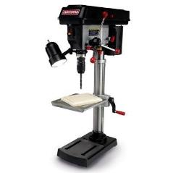
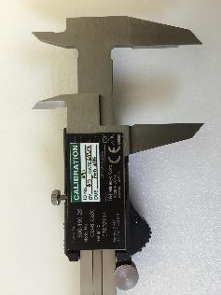
Equipment management
Process
Mary Johnson
CEO
Wavelength Electronics
Robert Martin
Quality Manager
Autopilot

Slide 2


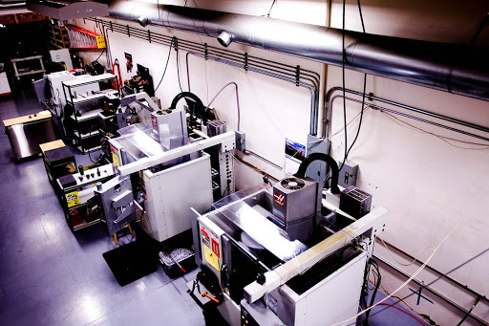
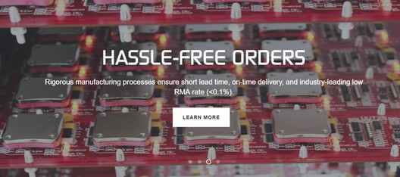
High Performance Electronics:
Laser Diode and QCL Drivers &
Temperature Controllers
Two SMT lines – Stencil printer, Pick-and-Place robots, reflow ovens
Selective Solder machine
Electronic meters
Hand tools
World Class Design and
Manufacturing
Contract design and manufacturing services
CNC milling, turning, anodizing, laser etching, assembly, packaging, etc.
ISO 9001/AS9100 Compliant Quality Management System
Required to meet customer spec’s, costs, and timelines
Notes:
Who is Wavelength
Wavelength Electronics Inc. was founded in 1992 by husband and wife Chuck & Mary Knighton. Chuck is now Chief Technical Officer and Mary is CEO. Both have degrees in Electrical Engineering.
Wavelength is a privately held corporation.
Early on, only instrumentation was available for operating laser diodes and thermoelectrics. We saw an opportunity to offer the technology packaged as components and modules. We have successfully tapped several markets averaging 26% growth annually.
In short, Wavelength simplifies advanced control technology so innovative tool developers with limited electronic design resources can achieve cutting edge performance.
Our technology platform currently consists of high performance temperature controllers and laser diode drivers.
Temperature Control == best commercially available temperature stability 0.001°C
Laser Diode Drivers == lowest noise, most stable current source ???
The high performance platform is accompanied by innovative packaging that makes the technology easy to use
R&D works with various universities on core control technology research. We will be introducing a new control technology this summer.
Thorough, Reliable, Responsive Technical Support is key to establishing the position of authority & knowledge with customers.
We have developed sophisticated web based tools to enhance technical support. These include searchable FAQs, design calculators, and technical and application notes.
We have a facility in Bozeman, Montana, USA. Services includes sales and technical support, engineering, and low volume / high mix manufacturing. High volume manufacturing is sub-contracted.
Our primary success has been with these markets: electro-optics, semiconductor manufacturing, bio-medical, military, research and university. We have had some success with the fiber optic and telecom markets and want to team with Richardson to more thoroughly serve these customers.

Slide 3
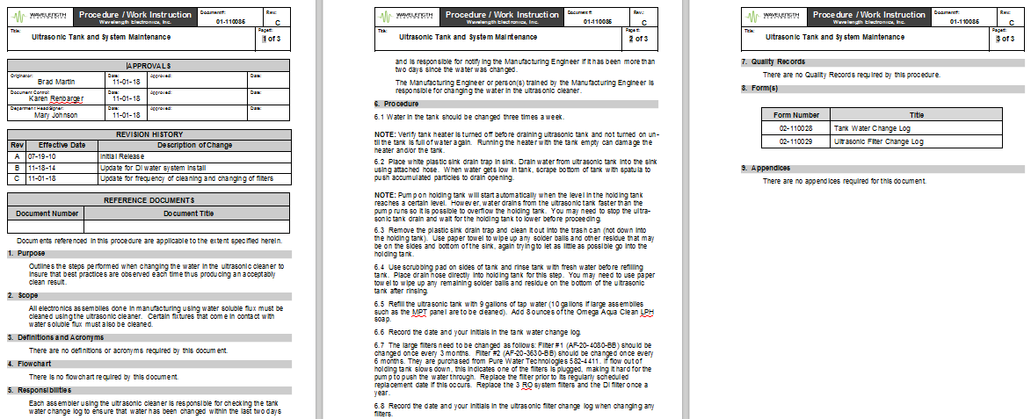
Preventive Maintenance
Preventative Maintenance
Problem: If the Ultrasonic Cleaner doesn’t clean flux off the printed circuit boards, production stops OR products fail in the field
Solution: Daily, Weekly, Annual maintenance protocols
  Established based on testing and our experience
  Documented with logs to make sure it’s done & if something goes wrong we have a dated history (traceability) to research root cause

Slide 4
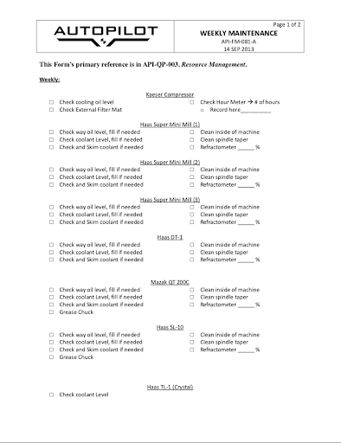
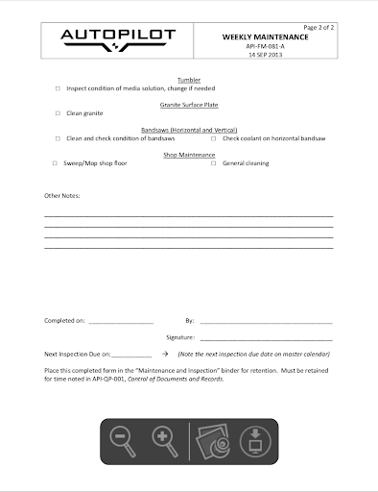
Preventive Maintenance
Problem: A project specific tool change guideline was not followed leading to a machine crash
Solution: Daily, Weekly, Monthly, Quarterly, Annual maintenance protocols
Machine maintenance recommendations pulled from manuals, then transcribed onto maintenance records to streamline process
Documented with records to make sure it’s done & if something goes wrong we have a history to research root cause

Slide 5
Calibration
Calibration
Calibration
Problem: If units pass test when meters are out of calibration, we are not measuring what we think we are measuring. RMAs increase and customers are not pleased.
  Applies to meters, oscilloscopes, power supplies, spectrum analyzers...
Solution: Electronic test results must be NIST traceable.
  Bring in third party to calibrate on-site every 51 weeks. Record Before & After data.
  Share travel cost with another local company

Slide 6
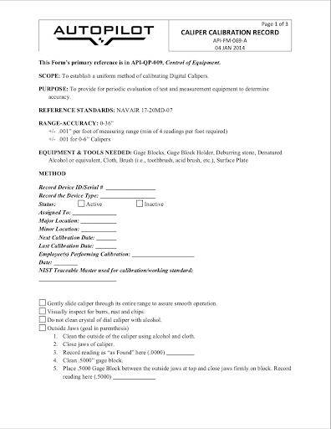


Calibration
Problem: If our measuring tools are not accurate and precise, we are not measuring what we think we are measuring, and customers send back more parts.
Applies to calipers, depth gauges, etc.
Solution: Create detailed process and form for calibration
Created from industry best practices
Detailed enough that anyone given proper materials could calibrate
Doubles as a record for tracking frequency of testing and life of precision tools

Slide 7
?
Questions To Ask Yourself
What Questions to Ask?
What questions to ask...
Preventative Maintenance
  Do you have equipment that can wear out, but is critical to throughput & efficiency or product performance?
  Do you know it’s been maintained adequately?
  Will you know when something is going out before you have a pile of scrap?
  Do you know the maintenance needs
  and costs of new machines you’re
  adding to your process?
Calibration
  Do you have measurement equipment
  you depend on to ensure product
  meets specification?
Maintaining key infrastructure prevents line down in production!
Calibrating your measuring equipment gives you confidence in your products

