Slide 1


Slide 2
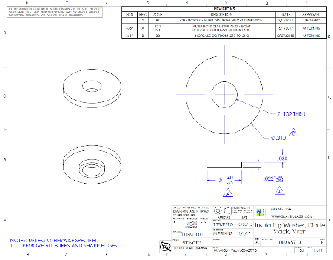
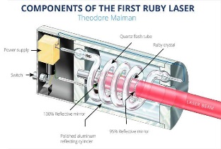

Document Control
How to organize your organizational knowledge in Six easy steps

Slide 3
Why document?
Have you spent way too much time searching for a drawing or work instruction that you need?
Do you have two versions of the same revision?
Do you have two revisions of the same version?
Have you ever ordered the wrong revision from a supplier?
Have you ever built the assembly the wrong way because you had an obsolete work instruction?
Do you have technicians building your design but not in the way you designed?
Have you ever had someone really experienced leave the organization… with all of their knowledge?
Have you ever lost a document with a lot of useful information, maybe even a key design?
Are you planning on training other personnel to build the design the way you designed it?
Have you trained personnel who now train other personnel…but not the way you trained them?
If the answer to any of these questions is yes?
Implement a Document Control System

Slide 4
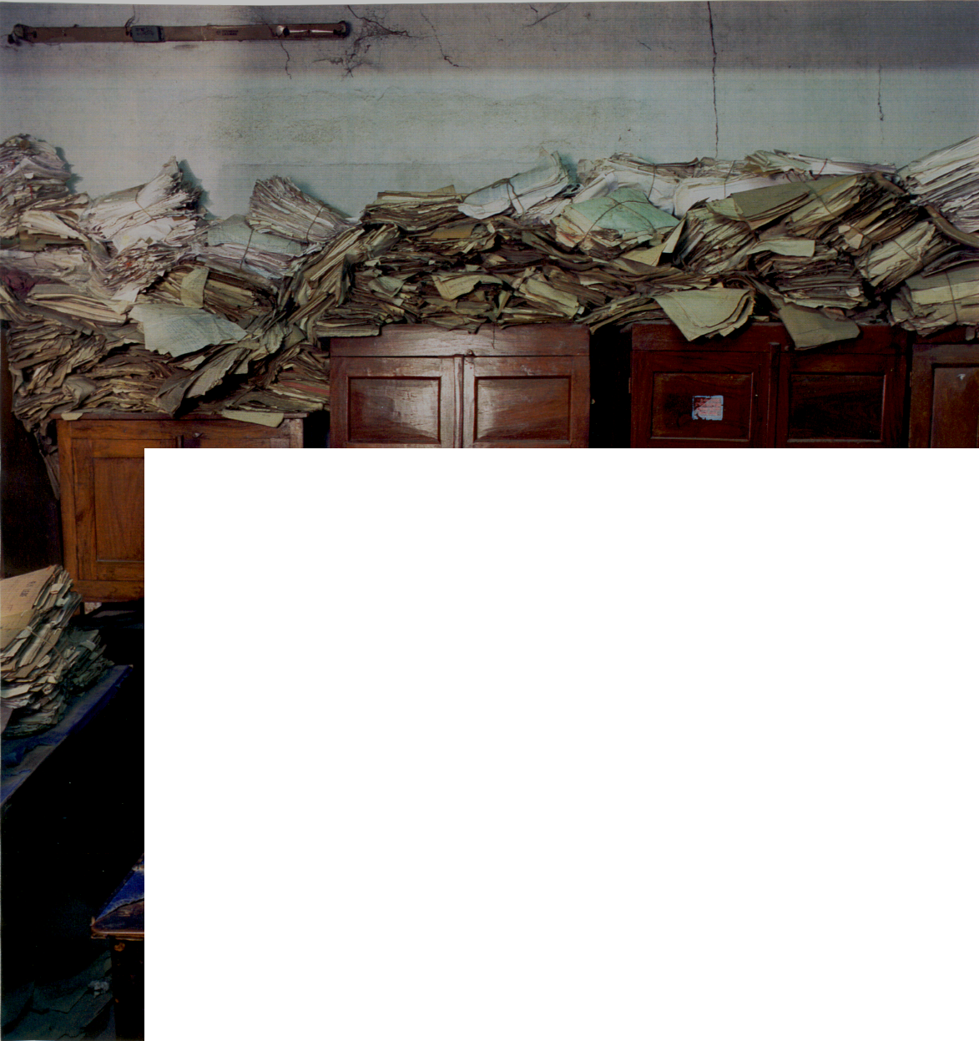

Good document control is essential!
Do you want this?
You get to choose?
Or do you want this?

Slide 5
Document Control Components
Storage
Location
Protection
Unique Identity (Templates)
Review and Approval
Document Management Process (Change Control)

Slide 6






Step 1: Storage
Build a Document Library

Slide 7
Basic Document Library Folder Structure
Document
Library
Create a Folder
Name it something really obvious like “Document Library”
“Library” evokes the idea of storing knowledge.
Current
Revisions
Create another folder within the Doc Library called “Current Revisions”
Only current revision of your documents go into this folder
This where everyone goes to get the Current Revisions document
Document Archive
This folder stores obsolete revisions.
Serves as a history for future reference only.
No one should pull documents from here unless it is part of some kind of inquiry, root cause analysis or some other purpose for understanding the history and evolution of the process.

Slide 8
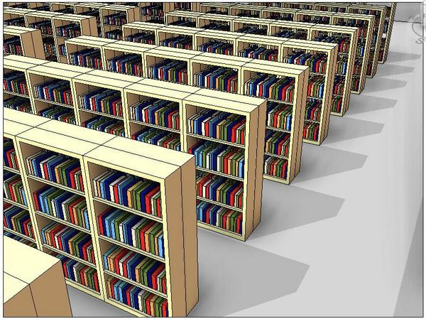
Current Revisions – Released Drawings
Document
Library
Rev A
Documents are placed in here when you are ready to “publish” them
Released to the Document Library
Current
Revisions
What does “publish” mean?
You want to make this document available for others to use.
  To send this document to a supplier
  To give this document to someone who is going to perform a function (e.g. a technician who is going to use it to build your product)

Slide 9
Document Archive
Document
Library
Rev B
New improved version
Pull Rev A from the doc library and save it with a new rev letter.
Revise the document
Forward it to the document library
Rev A
Current
Revisions
Rev A
Old and obsolete version
Move the previous revision of the document into the Document Archive folder (archived) .
Document Archive

Slide 10

Hardcopies
If you don’t have computers at workstations, create a Controlled Documents Binder to store hardcopies
Manage this binder like the current revision folder.
Don’t need to retain obsolete revisions.
Controlled
Documents
Advantage: these can be placed at point of use and are mobile
(Great for multiple workstations).
Disadvantage: takes more energy to ensure it stays current with Current Revisions Folder.

Slide 11
Step 2: Accessibility: Location, Location, Location
Document Library
Technicians
Buyers
Authors of next revisions
Trainers
Place Document Library in a centralized location easily accessible by your organization.
Place it on a secure network.
Place it at a high level in the folder structure.
Encourage personnel to create a shortcut to it on their computers.

Slide 12
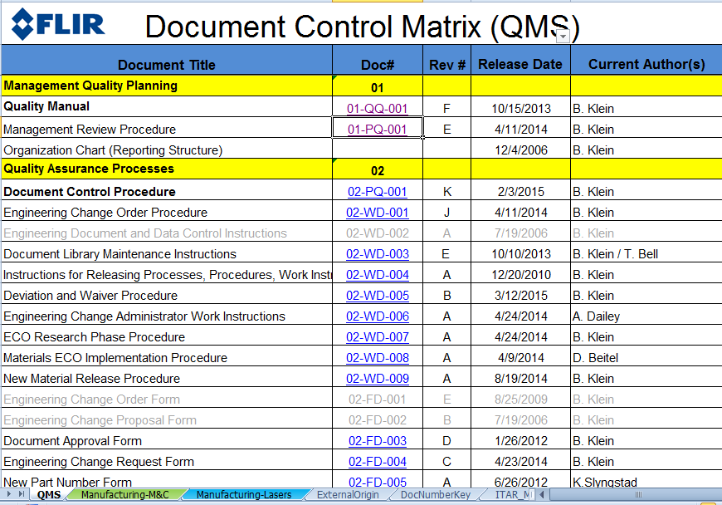
Example Method for Accessing Docs
Simple Excel Document Control Matrix serves as a directory with hyperlinks to current documents
hyperlinks to current documents

Slide 13
Step 3: Protection
READ ONLY The documents stored in the Document Library and all of the subfolder are Read Only*
Information Security – Protect the folder system from unauthorized access
Back-ups – Make regular back-ups
*Read/write access
Read/write access will be required by the chosen few
Doc Control Admin – a person assigned to manage the library
Quality Manager – Person assigned the responsibility for maintaining the Quality Management System
Document Control Administrator or Coordinator
Assign a person to manage the Library (Write access).
They place the documents in the folder when they are approved and archive the obsolete revision.

Slide 14
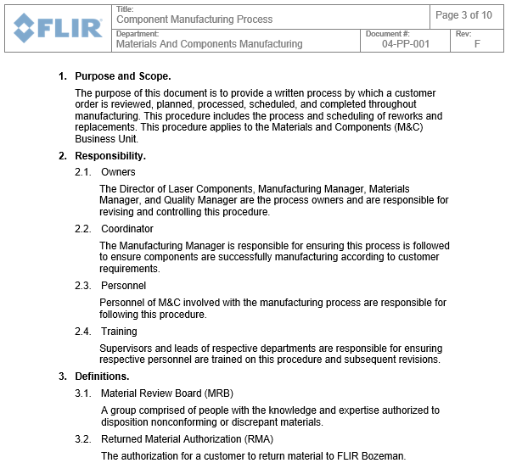
Step 4: Unique Identity: Templates
TOC
Logo
Title
Document #
Unique identification in header
Rev Level
Department/Area

Slide 15
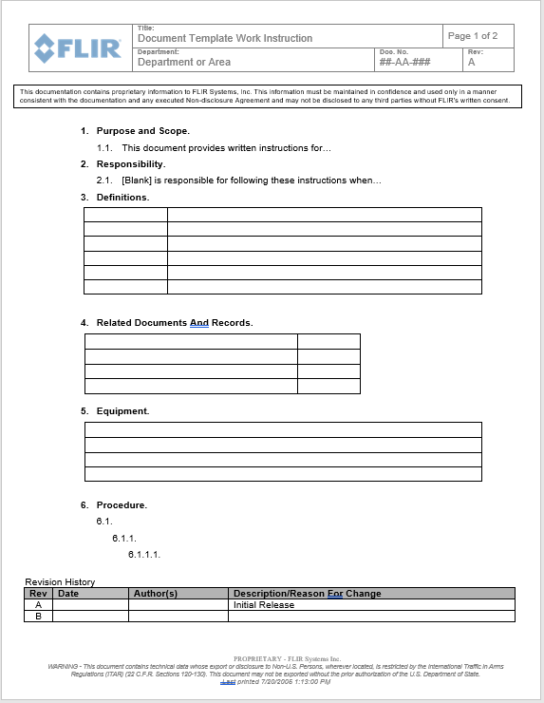
Procedure (Outline)
TOC
Purpose and Scope
Responsibility
Owner, Coordinator, Participants
Definitions
Related Document
Equipment (for Work Instructions)
General Section (for procedures)
Process Steps
Revision History
What was changed, by whom and when.
ITAR and Proprietary statement in footer

Slide 16
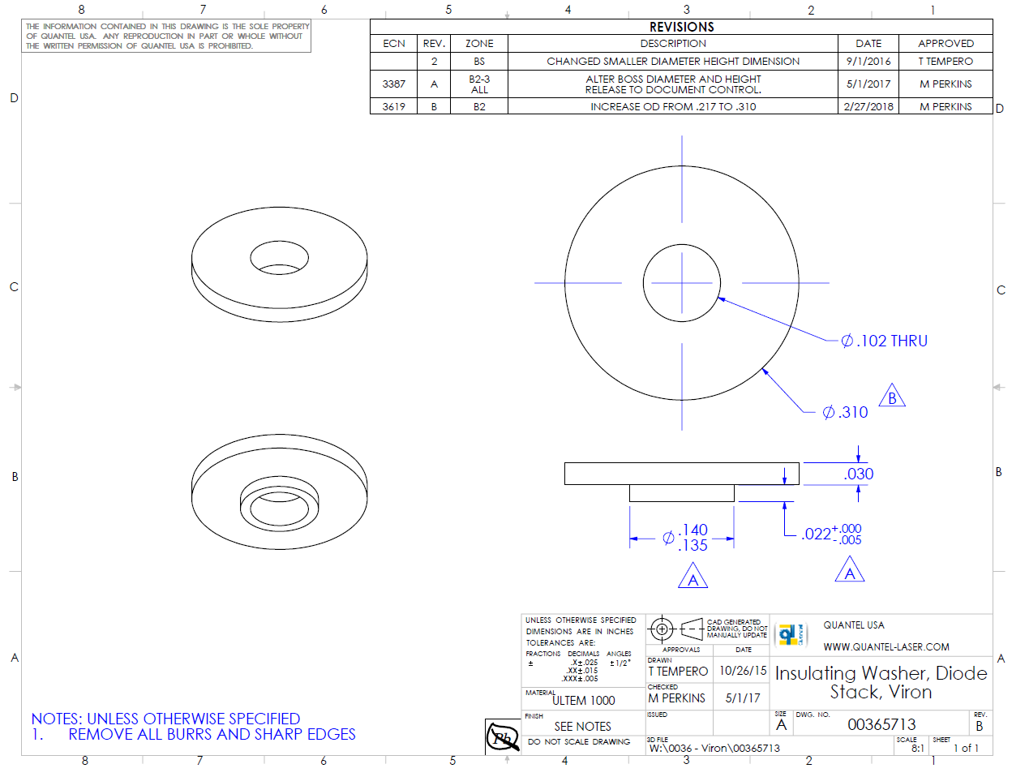
Drawing Template
Proprietary Statements
Export-Control Statements
Revision History
Notice that the revision goes from Rev 2 to Rev A.
This represents release from engineering to production.
Title
Notes
Revision
Approvals
Doc number (part number)

Slide 17
Templates Folder in Doc Library
Document
Library
Current
Revisions
Document Archive
Templates
Procedures, Work Instructions, Forms, Specification Documents, Drawing templates (unless this is controlled in more sophisticated software).

Slide 18

Step 5: Review and Approval
Review it to make sure it is ready to be published
Approve it to allow it to be published.

Slide 19

Who Approves
Author for the document
Process lead (process owner) who is responsible for the successful output
  If process affects more than one department, may want each department lead to approve.
Subject matter expert (such as an engineer)
  Someone with the knowledge that can assess the risk of the change.
Document Control Administrator
  The person who is overseeing the Document Control Process.
  TIP: You may have it reviewed by several people. Not everyone who reviews it is required to formally approve it.

Slide 20
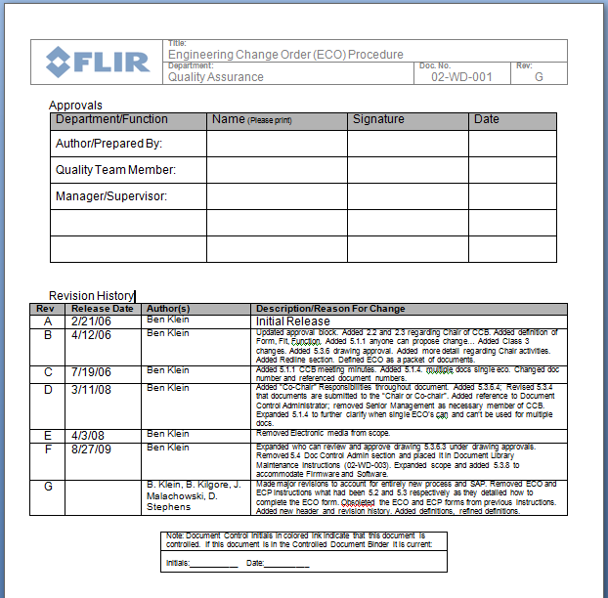
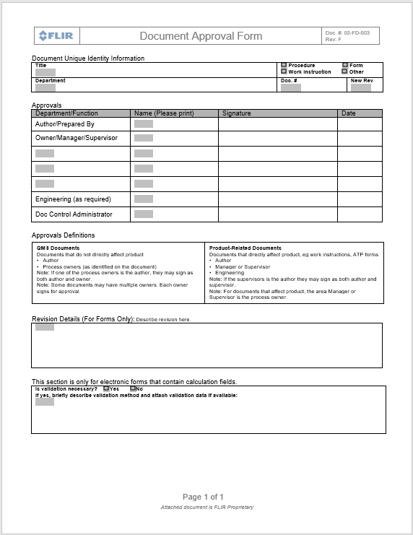
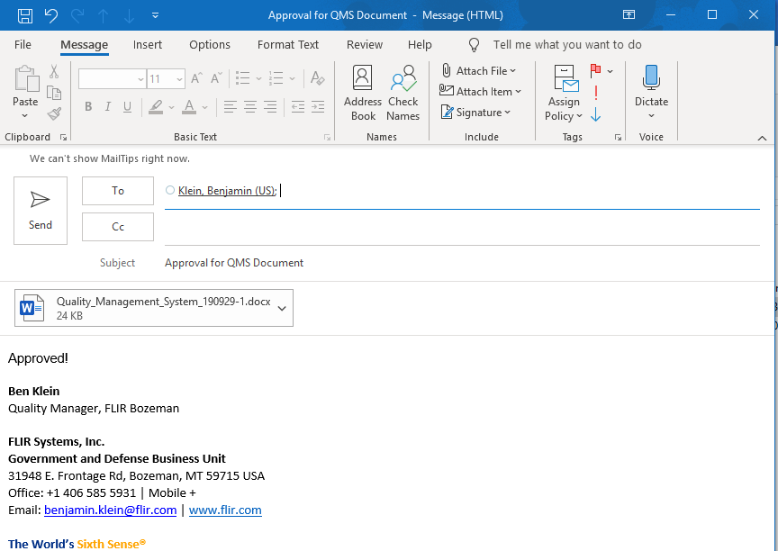
Mechanisms for Approval
TOC
Approval directly on the document
Approval on a separate form
Approval through an email chain
SAP
Or
Doc System
Retain Record of Approval

Slide 21
Step 6: Document Management Process
Change Control Process
Authorization
Should the change even be made?
Will the change appropriately resolve the issue? Will it introduce risk? Are there other related controlled items that will need revision (Work Instructions, Quality Control forms, etc.)
Validation
Make Change!
Create new/updated document.
Approval
Submit change to review from representatives of all impacted parties (Customer Service, Production, Purchasing, etc.)
Store new revision in Document Library
Archive old revision
Update Stock, Open Work Orders, purchasing info, inspection plans, work instructions, etc.
Implementation
Distribution
Document Control Admin notifies all relevant employees of change.
Training
Purchasing notifies Suppliers (for drawings or instructions)
Notes:
Some companies will change PN for any change to form, fit, or function; others will only change the Rev. Do at least one of these things!

Slide 22
Summary
When to control documents
Characteristics of Controlled Documents
Do you want it safe?
Do you want everyone working to the same version?
Do you want to find it fast?
Do you want a record of changes?
Document Title
Document Number
Revision Level
Common Format (Templates)
Revision History Table
Proprietary Statement
Process for making changes
Stored in Document Library
  Central Location all can access
  Current Revisions
  Limited Edit Access
Examples of Controlled Documents:
Procedures
Work Instructions
Specifications
Drawings
Forms
Regulatory Requirements and Standards

Slide 23
Open Forum
This slide deck will be available at the MPIA website

Slide 24
Case Study
Version Control
Document Numbering Systems

Slide 25
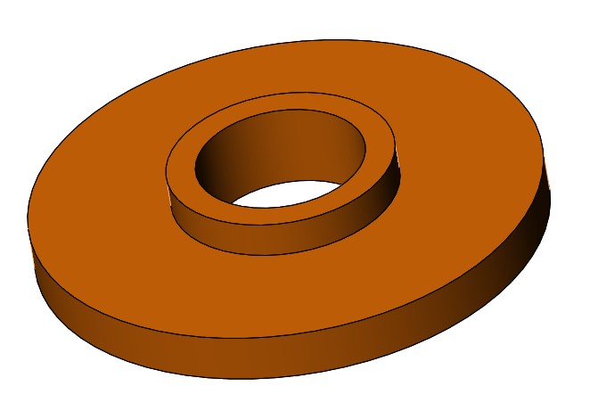
Background Information (Context)
A simple insulating washer used inside a solid state laser system.
This washer provides electrical insulation between mating components, as well as preventing other nearby metal parts from touching electrical contacts.
If the metal parts touch the electrical contacts, a short can occur and the system will stop working.
Notes:
Simple, but important part!

Slide 26
Document Management: Problem
Problem: The washers are ordered, received, pass incoming QC, are cleaned, and put in to production, however electrical parts start shorting and damaging during assembly.
Investigation determined the washers were made to an old revision and the O.D. is too small. The parts will need to be scrapped and replaced.
Two week lead time to get replacement parts. Production schedule is interrupted. Delivery schedules to customers are at risk. Damaged parts need to be replaced. Resources investigating the cause. $$$$$$$$$$$$$$
A design change was made but not formally communicated to the supplier or the incoming inspector.
Simple Part, Minor Change, Significant Impact
Notes:
Simple part, minor change, Large impact to quality of product (potential for products failing in the field)!

Slide 27
Document Management Process
Solution: Design a process to create, store, and make changes to information needed to build your product (Change/Engineering Control Process).
Documents are stored in a central location and changes are managed by a Document Control person. Everyone has access to the most current version of the documents they need and changes are validated, approved and distributed accordingly.
Return, rework and scrap rates have declined.
Do it right the first time!

Slide 28
Questions to Ask Yourself
?
Have you ever ordered the wrong revision part?
Have you built an assembly using the wrong type of materials?
Do you have failures in the field because a change designed to prevent an intermittent failure had not been implemented?
Are you struggling to figure out what the latest drawing/procedure is and where to get it?
A minor change to a simple part can have a significant impact on the quality of your product. Having a Document Control Process can provide you with the consistency you need to build quality into your products, train new employees, reduce rework and scrap and thereby increase profitability.

Slide 29
Version Control
A critical part of unique identity is the use of a revision level to maintain version control.
Generally revisions are numeric or alpha.
It is common to use revision numbers for engineering level documents and alpha once the document (drawing or work instructions) is released to production
Example: Numeric goes, rev 1, 2, 3, 4, etc and roles to rev A when it is released to production.
Start with Rev A, the Rev B and so on
After Rev Z, Rev AA, AB, AC, etc
Software may use decimal places.
Not uncommon to use both alpha and numeric to control record changes, ie Rev a to Rev A1 (Eg. Revision to a doc title, to replace a footer with a new statement, to add a logo. Does not change form, fit or function or process design. )

Slide 30
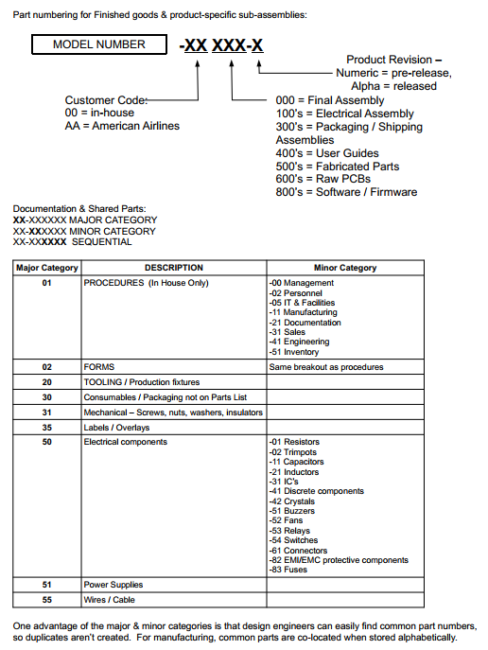
Document Numbering System Examples
Team Wavelength
4100914 – Seven-digit number generated by a doc control system, ERP system, or
05-WL- 010
Last three digits = indexed number (001, 002, 003, etc)
First digits
1st Character 2nd set
2nd Character 2nd set
Document Type | Description
01 | Leadership
02 | Document Control
03 | Support (eg Calibration, Training)
04 | Supplier Related
05 | Manufacturing
06 | Measurement and Improvement
Document Type | Description
Q | Quality Document
P | Procedure
F | Form
W | Work Instruction
E | Electonric Form
R | Process
Department Letter | Description
I | Inspection (M&C QC)
G | Growth
F | Fabrication
P | Polishing
C | Chemlab
Z | Manufacturing Processes M&C
L | Lasers Manufacturing
M | Materials and Quality for lasers
S | Service Lasers
Reference the following book for more information
Engineering Document Control Handbook
(Configuration Management and Product Lifecycle Management)
By Frank B. Watts

Slide 31
Document Numbering System Examples
CC-XXXXXX-NN
The CC stands for “commodity code”. This part is intelligent. Different types of parts fit into different commodity codes. There are different commodity codes for:
Fastener
cable harness
machined part
inseparable (e.g. welded) assembly
kit of parts
assembly
production procedure
raw material
and many others. Implied here are that you are going to have <99 different commodity codes. If not, then you’ll want to use 3 digit commodity codes.
The XXXXXX is a non-intelligent number that simply increments up every time someone pulls a part number. This could also be a random 6 digit number. Importantly, the same 6 digit number is never reused, even on different commodity codes. This gives some redundancy to the part number, so that if someone gets the commodity code right but one of the 6 digits wrong, chances are that they will have an invalid part number rather than a valid part number but the wrong part.
The NN is typically -00 for most parts. However it is used for very similar parts that have multiple variants. For instance, if you had a housing that came in 6 different colors, then the drawing for the housing would show the mechanical design and then have a table illustrating the variants. Something like:
-01 | unpainted
-02 | white
-03 | black
-04 | yellow
-05 | blue
-06 | red
Similar logic applies to fasteners or cable harnesses that are identical except for length, or parts that can be made in various alloys, etc. Makes it easy to release or update a series parts that are almost the same, but with minor variations, without having to update many different (redundant) drawings.
article outlining some pros and cons of intelligent vs non-intelligent part numbering systems:
https://www.arenasolutions.com/resources/articles/part-numbering/

Slide 32
Document Numbering System Examples
Additional elements of this system:
Each part # has a revision to it. Numerical revisions are used for engineering, and are relatively easy to change. Alphabetical revisions are used once a part is released into production, and require a lot more info and approvals to change.
Changing form, fit, or function on a part requires a new part number. This is not always followed at the engineering (numerical) rev level, if the responsible engineer can guarantee there are no parts of earlier revisions (with the same part number). For instance, if you had 2 prototypes made in the -01 design, and destroyed the first in testing while figuring out you need to modify the design, and then you make the -02 rev and you can rework the remaining -01 part to the -02 design (or discard it entirely), that’s ok. Or if you decide to loosen a tolerance on a part, that’s fine, because older rev parts still meet the new drawing. But it is absolutely not ok to ever have parts in existence that do not conform to the current rev of that part number. So if you tighten rather than loosen a spec, you either need to change part number or discard/rework all parts that don’t meet the new tighter spec. This guarantees that someone that picks up a part with a given part number can always use that part. In practice, this means that people often have to change part numbers for similar parts. That’s ok.
The –NN portion of the part number is “-XX” for the engineering drawing itself. So if you are holding part 42-035839-00 and want to see the drawing, you look up 42-035839-XX.
For parts or systems that can be refurbished, one adds an “R” to the part number to designate a refurbished item. This does not seem like the most elegant system, but it is much better than mixing new and refurbished parts in the same part number, and avoids complications that come from having an entirely separate part number for refurbished parts.

Slide 33
Reference Folder
Document
Library
Current
Revisions
Reference Documents
Documents of external origin
Standards
Mil-specs
Useful information
Very loose control
Document Archive
Templates

Slide 34
Document Library
Current
Revisions
Document Archive
Templates
Reference Documents

