Slide 1


Document Management Process
Kim Rollefson & Conlin Ritter

Slide 2
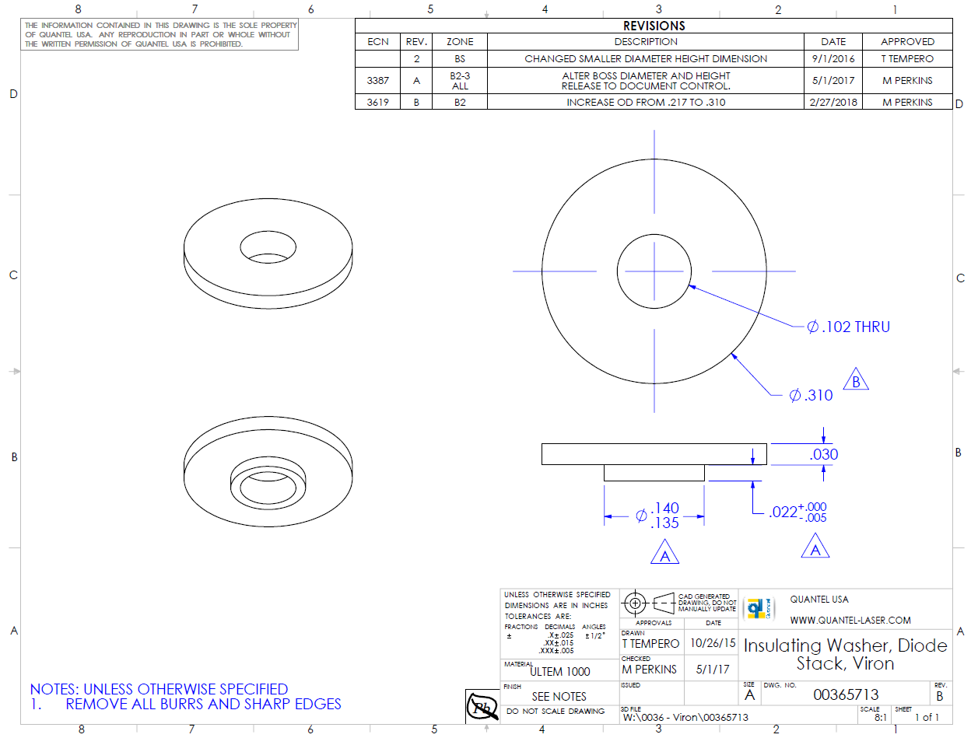
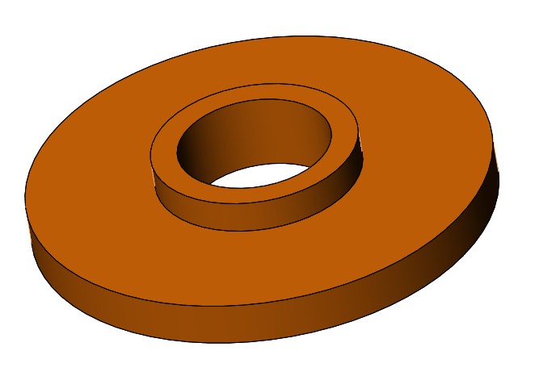
Background Information (Context)
A simple insulating washer used inside a solid state laser system.
This washer provides electrical insulation between mating components, as well as preventing other nearby metal parts from touching electrical contacts.
If the metal parts touch the electrical contacts, a short can occur and the system will stop working.
Notes:
Simple, but important part!
1

Slide 3
Document Management: Problem
Problem: The washers are ordered, received, pass incoming QC, are cleaned, and put in to production, however electrical parts start shorting and damaging during assembly.
Investigation determined the washers were made to an old revision and the O.D. is too small. The parts will need to be scrapped and replaced.
Two week lead time to get replacement parts. Production schedule is interrupted. Delivery schedules to customers are at risk. Damaged parts need to be replaced. Resources investigating the cause. $$$$$$$$$$$$$$
Simple Part, Minor Change, Significant Impact
Notes:
Simple part, minor change, Large impact to quality of product (potential for products failing in the field)!
1

Slide 4
Document Management Process
Solution: Design a process to create, store, and make changes to information needed to build your product (Change/Engineering Control Process).
Documents are stored in a central location and changes are managed by a Document Control person. Everyone has access to the most current version of the documents they need and changes are validated, approved and distributed accordingly.
Do it right the first time!

Slide 5
Engineering Change Control Steps
Authorization
Should the change even be made?
Will the change appropriately resolve the issue? Are there other related controlled items that will need revision (Work Instructions, Quality Control forms, etc.)
Validation
Make Change!
Create new/updated document.
Approval
Submit change to review from representatives of all impacted parties (Customer Service, Production, Purchasing, etc.)
Store new revision in central storage area. Archive old revision (for Customer Service & Engineering reference). Update Stock, Open Work Orders, purchasing info, inspection plans, work instructions, etc.
Implementation
Distribution
Document Manager notifies all relevant employees of change. Purchasing notifies Suppliers.
Notes:
Some companies will change PN for any change to form, fit, or function; others will only change the Rev. Do at least one of these things!
1

Slide 6
Document Control System
Characteristics of Controlled Documents
Should It Be Controlled?
Document Title
Document Number
Revision Level
Process for making changes
Common Format
Revision History Table
Proprietary Statement
Stored in Document Library
  Central Location all can access
  Current Revisions
  Limited Edit Access
Do you want it safe?
Do you want a record of changes?
Do you want everyone working to the same version?
Do you want to find it fast?
Examples of Controlled Documents:
Work Instructions
Specifications
Drawings
Procedures
Forms
Regulatory Requirements and Standards

Slide 7
Common Characteristics of Controlled Document
Revision History
Title
Revision
Doc number

Slide 8
?
Questions to Ask Yourself
Have you ever ordered the wrong revision part?
Have you built an assembly using the wrong type of materials?
Do you have failures in the field because a change designed to prevent an intermittent failure had not been implemented?
Are you struggling to figure out what the latest drawing/procedure is and where to get it?
A minor change to a simple part can have a significant impact on the quality of your product. Having a Document Control Process can provide you with the consistency you need to build quality into your products, train new employees, reduce rework and scrap and thereby increase profitability.

