Slide 1
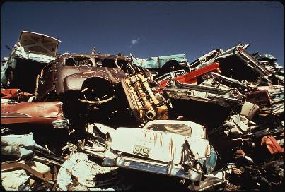
MANAGING DISCREPANT MATERIAL
Ben Klein
Quality Manager
FLIR Systems, Inc.

Slide 2
Discrepant: Definition
Definition: differing, disagreeing, inconsistent (dictionary.com)
Discrepant may be nonconforming (does not meet specification per drawing)
Discrepant may not be nonconforming
  Doesn’t fit due to tolerance stack-up, strange color, finish isn’t quite right
Sources of discrepancy
Incoming inspection – generally supplier caused)
During manufacturing – either supplier or process caused)
Returns from customer - Service Returns

Slide 3

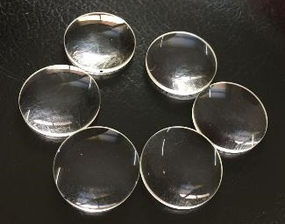

Discrepant Material: Problem
Problem: Discrepant lenses are starting to pile up next to the final assembly station
A laser was accidentally built and shipped with one of the discrepant lenses
Two months later, the Customer returned the Laser because it “stopped working”
The laser fried a bunch of parts because of discrepant lens. Cost thousands of dollars to repair! $$$$$
Bozeman Lasers

Slide 4
Discrepant Material: Solution
Solution: Design a process initiated any time Discrepant Material is encountered
Label Discrepant Material and Segregate
Record information in Discrepant Material Log
Evaluate Discrepant Material
Update Discrepant Material Log
Scrap
Rework/Repair
Return to suppler
Use as is
Determine Disposition
Disposition Material

Slide 5
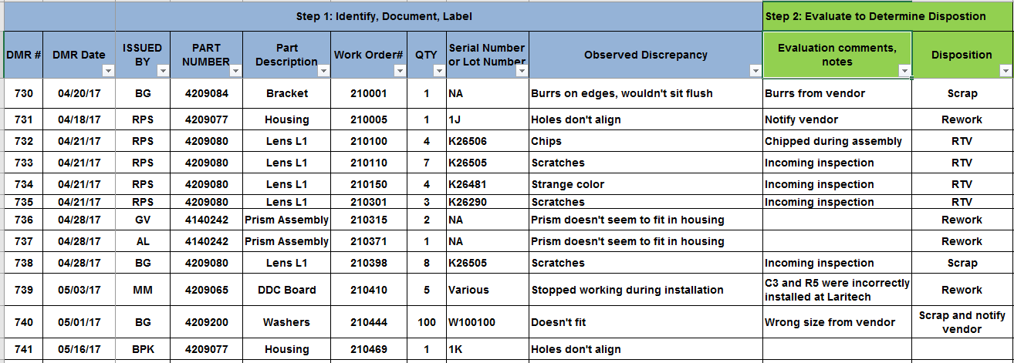
Discrepant Material Process
Discrepant Material is never accidentally incorporated into final product.
A record of Discrepant Material is generated. Trends lead to improvements.
Returned material has declined. Manufacturing costs decreased. Improved yield.
Discrepant material gives insight regarding the design, the performance of your suppliers, performance of your processes.

Slide 6

Service Returns: Problem Statement
Problem: Lasers returns are increasing in qty
Returned lasers are misplaced; long time before returning to the customer
Customers are not happy and considering another source for lasers
We have no idea how many are returning and no idea of the product reliability

Slide 7
Service Return Process: Solution
Solution: Design a process initiated any time Lasers are returned by a customer
Label the Returned Material
Record in Log
Evaluate Returned Material
Updates Log
Warranty
Determine Warranty Status
Non Warranty
Determine Disposition
Replace
Rework/Repair
Return to Customer
Disposition
Return to Customer

Slide 8
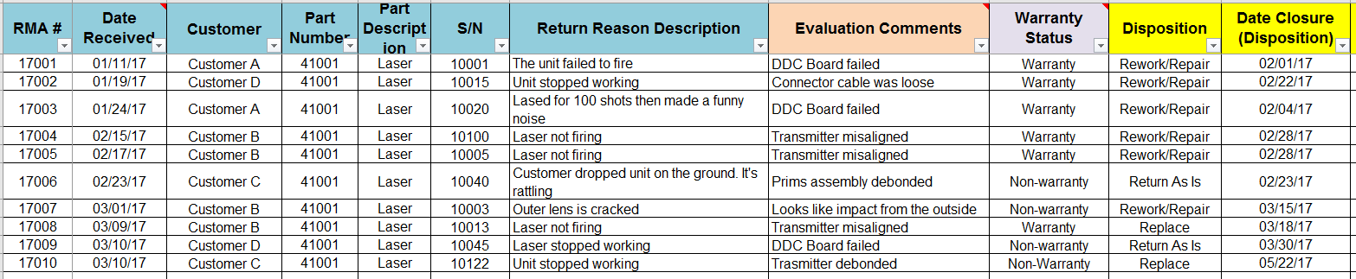
Service Return Process
A record of Returned Material is generated and tracked in a log
Returned Material isn’t lost or forgotten, trends identified lead to improved design/process
Log can be used to generate graphs (see next slide)
Each return event is an opportunity to improve relationships with your customers and build greater trust
How you respond to a return event is a moment of truth!

Slide 9
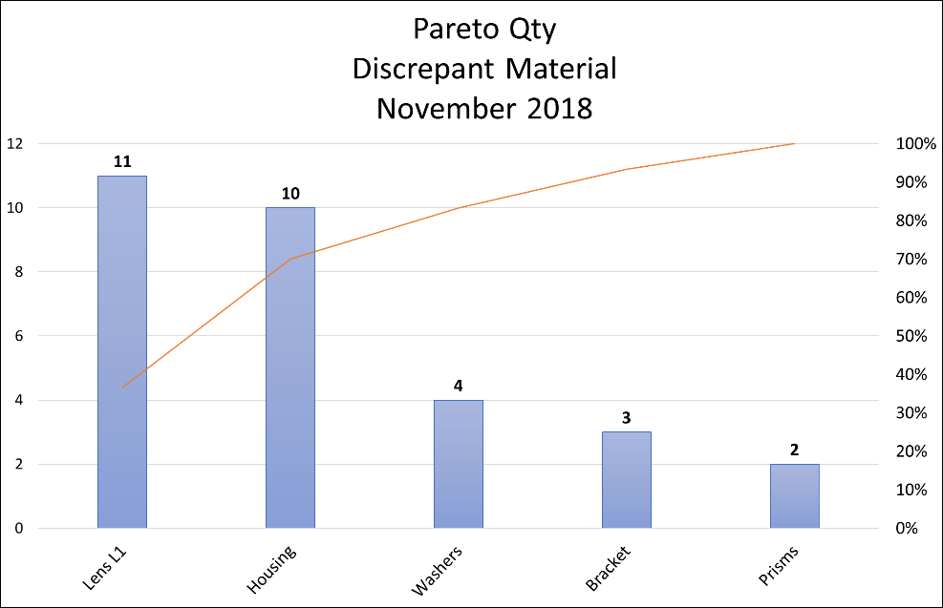
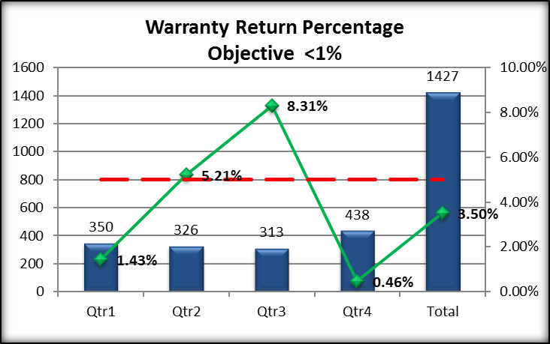
Discrepant Material Reports
Warranty Returns
Logs Provide Data
Design Change
Process Change
Supplier Change
Improvement

Slide 10
?
Questions to Ask Yourself
Do you know how many materials are being rejected from your suppliers?
Do you know how many materials are being damaged during production?
Do you know how many of your products are being returned from your customers?
Do you know what kinds of trends you are seeing in the returned products?
Understanding what doesn’t work leads to understanding what does work!

